Slide 1










Joint 5D Pen Input for Light Field Displays
James Tompkin, Samuel Muff, James McCann,
Hanspeter Pfister, Jan Kautz,
Marc Alexa, Wojciech Matusik
UIST 2015
Notes:
Thank you for the introduction. Hello everyone, I’m James. We first showed this work at SIGGRAPH in ETech in 2012, when I was still an intern at Disney Research working with Jim McCann (who is also here at UIST).
Thank you to everyone who came to play with our system on Monday

Slide 2
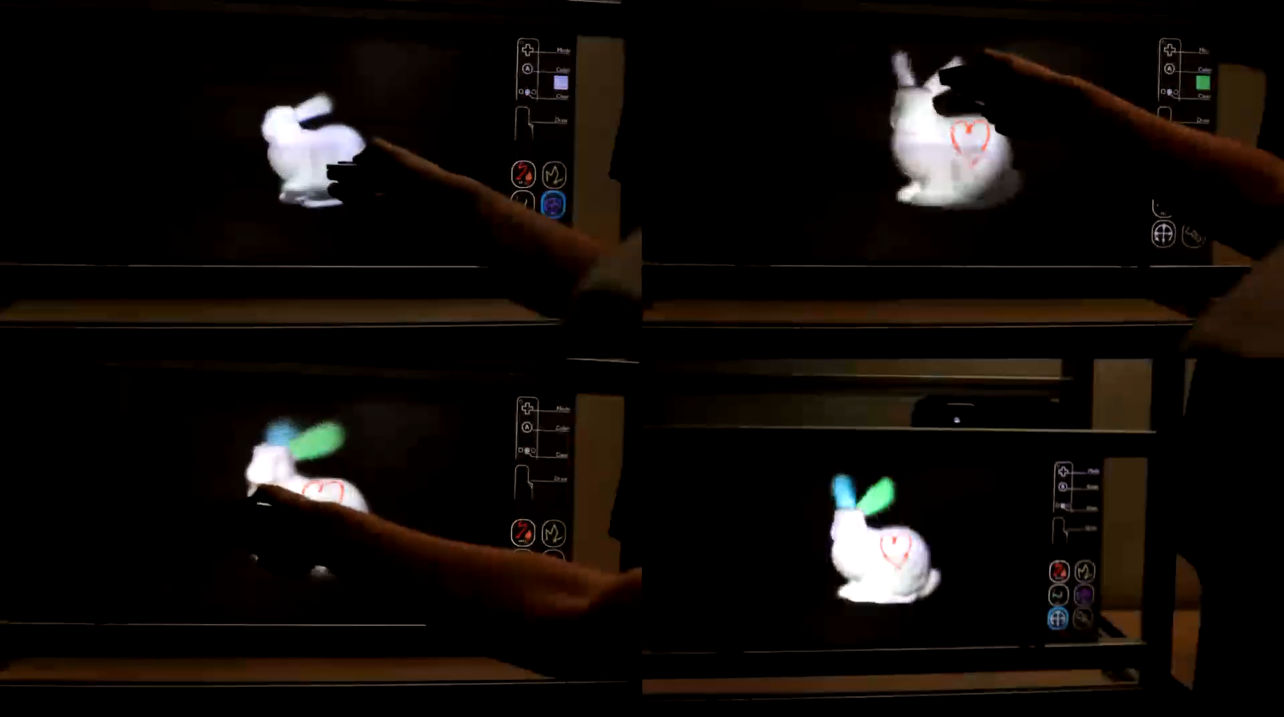
Notes:
If you missed it, then it’s a pen-based system that lets you view and interact in 3D with light, so that you can create and position objects in 3D, draw on and around objects with a pen in 3D, transform objects naturally in 3D space, light or relight objects with virtual flashlights in 3D, but also to _view_ all of this in 3D at the same time as you interact.

Slide 3
Notes:
If you missed it, then it’s a pen-based system that lets you view and interact in 3D with light, so that you can create and position objects in 3D, draw on and around objects with a pen in 3D, transform objects naturally in 3D space, light or relight objects with virtual flashlights in 3D, but also to _view_ all of this in 3D at the same time as you interact.

Slide 4
Notes:
If you missed it, then it’s a pen-based system that lets you view and interact in 3D with light, so that you can create and position objects in 3D, draw on and around objects with a pen in 3D, transform objects naturally in 3D space, light or relight objects with virtual flashlights in 3D, but also to _view_ all of this in 3D at the same time as you interact.

Slide 5
Notes:
If you missed it, then it’s a pen-based system that lets you view and interact in 3D with light, so that you can create and position objects in 3D, draw on and around objects with a pen in 3D, transform objects naturally in 3D space, light or relight objects with virtual flashlights in 3D, but also to _view_ all of this in 3D at the same time as you interact.
Before I explain how this is done, let’s just take a quick step back through display history…

Slide 6
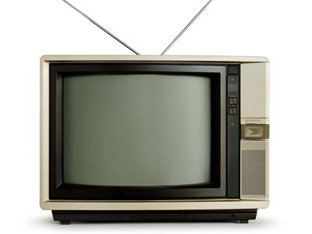

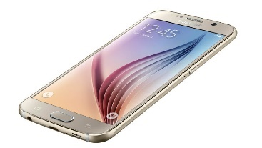
Display pixel density
My first monitor: 40 ppi
Apple ‘Retina’ laptop: 250 ppi
5” Smartphone: 500 ppi
Notes:
My first monitor was actually a PAL TV, with 40 pixels per inches density. <ADVANCE>
Laptop ‘retina’ displays are now at about 250 pixels per inch, <ADVANCE> and on a smartphone where you might hold it closer to your face, the ppi is about double.
Retina Macbook Pro (2560x1600 over 13 inches)
Galaxy S6 – 576 DPI (2,560 x 1440 over 5.1 inch screen)
Image credits:
http://static.ddmcdn.com/gif/1980s-tv.jpg
http://zapp0.staticworld.net/reviews/graphics/products/uploaded/apple_15inch_macbook_pro_with_retina_display_1218250_g1.jpg
http://cdn2.pcadvisor.co.uk/cmsdata/features/3531559/Samsung_Galaxy_S6_6_80.jpg

Slide 7
You: “Wow – my eye literally can’t see the pixels! Congrats everyone! Folks, we can stop now.”
Notes:
“Wow”; you say, “my eyes literally can’t see the pixels!”
“Congratulations everyone! Folks, we can stop working on this now and go and fix some other important problem.”
But then SAMSUNG butts in and says … <ADVANCE>

Slide 8

You: “Wow – my eye literally can’t see the pixels! Congrats everyone! Folks, we can stop now.”
: “No! 2250 ppi by year 2020!” (July 10th, 2015)
[http://english.etnews.com/20150710200002]
Notes:
…“No! 2250 pixels per inch by year 2020!”
Government is investing 26.5 million dollars by stages for 5 years hereafter. At 10th Display Field National Research Development Business General Workshop
This business is part of GiGA Korea’s business that is being led by Ministry of Science, ICT, and Future Planning (MSIP), and name of the project is EnDK. It is predicted that prototype can be shown to the public at 2018 Pyeongchang Winter Olympics at the earliest.

Slide 9
You: “Wow – my eye literally can’t see the pixels! Congrats everyone! Folks, we can stop now.”
: “No! 2250 ppi by year 2020!” (July 10th, 2015) You: “What!? Why? My eye can’t see the difference!”
Notes:
Incredulously, you claim “What!? Why? My eye can’t see the difference!”

Slide 10
You: “Wow – my eye literally can’t see the pixels! Congrats everyone! Folks, we can stop now.”
: “No! 2250 ppi by year 2020!” (July 10th, 2015) You: “What!? Why? My eye can’t see the difference!”
: “It’s for 3D!”
Notes:
SAMSUNG retorts: “It’s for 3D!”
But you’ve been to the cinema, seen the 3D movie, and got the headache. With determination, you insist: <ADVANCE>

Slide 11
You: “Wow – my eye literally can’t see the pixels! Congrats everyone! Folks, we can stop now.”
: “No! 2250 ppi by year 2020!” (July 10th, 2015) You: “What!? Why? My eye can’t see the difference!”
: “It’s for 3D!”
You: “Face it, , the dream is dead. Nobody wants to use 3D glasses.”
Notes:
“Face it, SAMSUNG, the dream is dead. Nobody wants to use 3D glasses for general displays.”
However, ever the mediator, I interject – “Children, children, this is all just a misunderstanding.” <ADVANCE>

Slide 12
You: “Wow – my eye literally can’t see the pixels! Congrats everyone! Folks, we can stop now.”
: “No! 2250 ppi by year 2020!” (July 10th, 2015) You: “What!? Why? My eye can’t see the difference!”
: “It’s for 3D!”
You: “Face it, , the dream is dead. Nobody wants to use 3D glasses.”
: “Not stereo 3D; LIGHT FIELDS!”
Notes:
“Not stereo 3D, but ‘L I G H T F I E L D S’!
2 minutes.

Slide 13
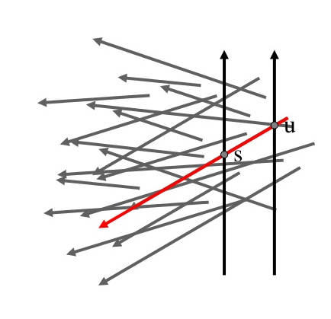
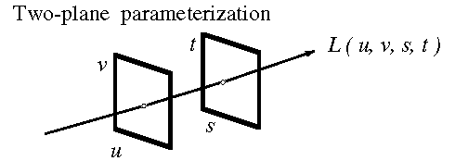
“But James, what is this light field?”
Capturing all rays of light
Either incoming to or outgoing from a scene.
Side view
[Levoy et al., CS 348B @ Stanford - https://graphics.stanford.edu/courses/cs348b-97/lightfield/lfparam.gif]
[Raskar et al., SIGGRAPH 2012 Course – Computational Plenoptic Imaging]
Notes:
But, what is a light field?
At the keynote on Monday, we heard Ramesh Raskar talking a lot about how light fields can help us make better displays.
We can think of a light field as capturing all of the _light rays_ which are incoming to a scene or outgoing from a scene.
A bit like looking through a window.
One way to parameterize these rays of light is by the two points at which the ray intersects two planes.
In the window analogy, this would be the front and back sides of the glass pane.
As we see from the side view, a light field is many of these rays.

Slide 14
“What does a light field give us?”
Imagine we want to look at virtual objects on a display as if we were looking at them in real life.
What would we need?
Notes:
Well, what does a light field give us?
Imagine we want to look at virtual objects on a display as if we were looking at them in real life.
<ADVANCE>
What would we need?

Slide 15





Looking at virtual ‘real’ objects
Two eyes
A neck and a body
Binocular stereo
Variable focus
Motion parallax
Notes:
Well, first off we have two eyes to see depth at near to mid distances – binocular stereo.
With our eye’s ability to change its lens shape through a process called accommodation, this also gives us the ability to verge and focus at different depths.
<ADVANCE>
Second, we have necks and bodies, and this allows us to move and look around objects – motion parallax.
How can we produce these effects?
Note my excellent current cultural references.

Slide 16
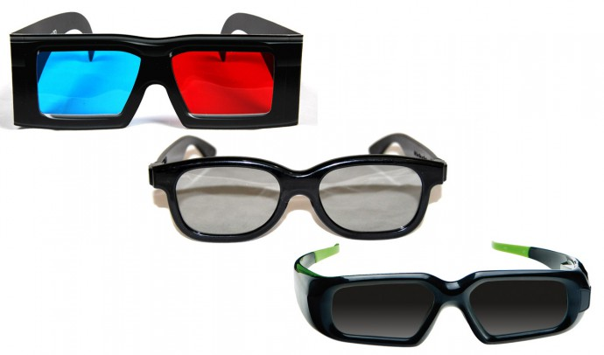
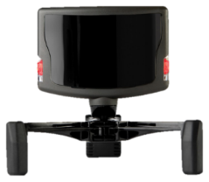
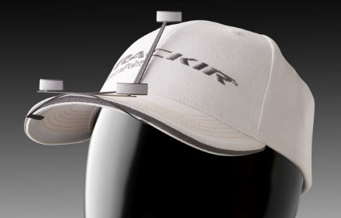
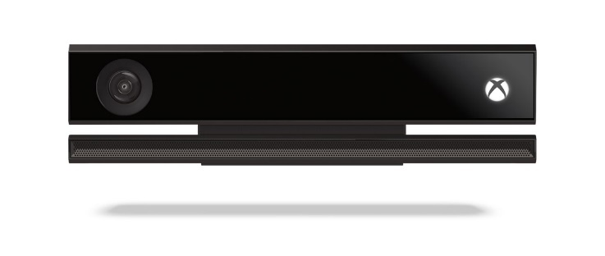
Binocular stereo
+ parallax displays
Anaglyph – color multiplexing
[Track IR]
Polarizing – phase multiplexing
Active shutter – temporal
multiplexing
[Microsoft Kinect V2]
Notes:
Now, we could accomplish some of this with stereo 3D glasses (though not comfortable accommodation and vergence), <ADVANCE> and with motion trackers we can do parallax for one person.
But this is unscalable for many people – every person we add to the system requires us to temporally multiplex the output with shutter glasses.

Slide 17
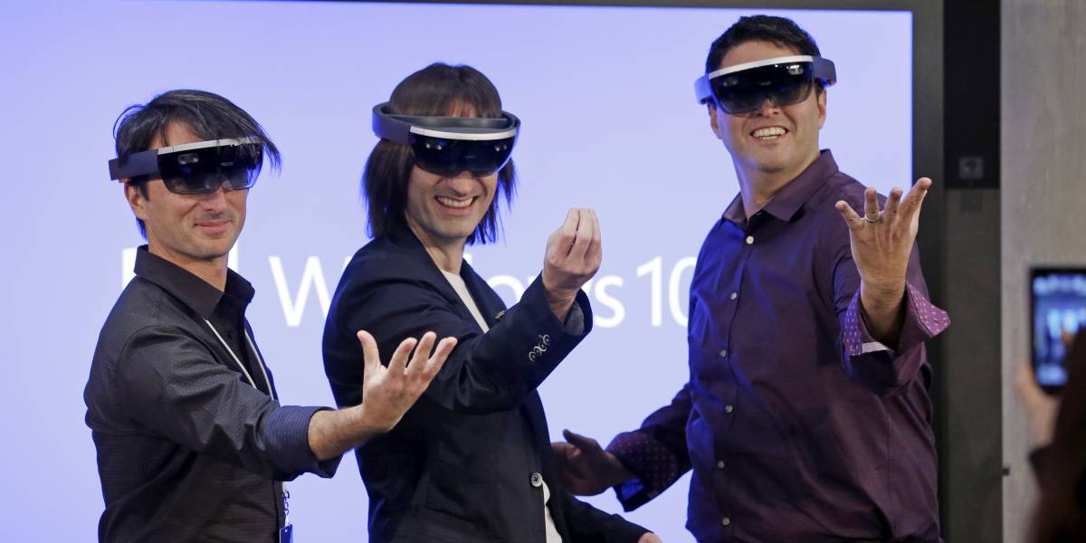
HMDs can be unscalable or unwieldy
[Microsoft HoloLens]
Notes:
We could fix this with VR headsets for everyone to explore a shared virtual space.
I’m sure Microsoft would love for us all to buy HoloLens units, but we’re still wearing a headset.
So what alternatives allow natural viewing?
3 minutes 30.
http://cdn2.pcadvisor.co.uk/cmsdata/features/3595323/Microsoft_HoloLens.jpg

Slide 18
Light fields via lenses
Lenslet array
Display pixel array
[Lippmann 1908 – Integral Photography]
Notes:
Well, we can use lenses to direct light in different directions by placing them over our display pixel array.

Slide 19
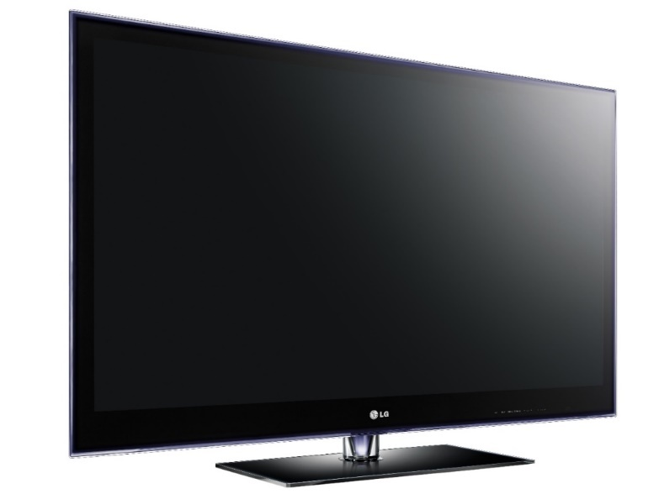
2D displays
~180 degrees
Pixels
Notes:
In a 2D display, each pixel spreads light over about 180 degrees.

Slide 20
Lenses
A plano-convex lens
Pixels
[Lippmann 1908 – Integral Photography]
Notes:
By adding a lens over a single pixel, <ADVANCE>

Slide 21
Lenses
Pixels
Notes:
not much changes. But…if we make the lens cover multiple pixels…

Slide 22
Lenses – Auto-stereoscopic
Pixels
Notes:
Then we can achieve auto-stereoscopy – binocular stereo with two views and without glasses.
We simply need to spatially multiplex or split up our image appropriately so that the right pixel is refracted in the right direction.

Slide 23
Lenses – Auto-multiscopic
Pixels
Notes:
Lenses covering three or more pixels would then give three views, and so be auto-multiscopic displays; and so on, with potentially many angular views.
These many views create our light field display – it gives us control over the color of light rays being emitted in different directions from the display. And, unlike stereo displays, we can focus comfortably at different depths because we’re able to produce a much larger depth of field.
Naturally, we can see a problem. For a fixed number of pixels, or pixel budget, as the number of angular views increases, our spatial resolution must decrease.
To overcome this spatio-angular trade-off, we need LOTS of pixels in our displays.

Slide 24
“So that’s why cares about PPI!”
2250 PPI = 10 x 10 views @ 1080p spatial resolution.
Glasses free…
…stereoscopic (multiscopic!)…
…parallax display!
Notes:
“AH-ha” – you say – “so that’s why SAMSUNG cares so much about beyond-eye-resolution high PPI displays.”
2250 PPI gives us about 10 x 10 horizontal and vertical views at equivalent 1080p spatial resolution.
This would be a glasses free, stereoscopic, focusable, parallax display, allowing us to produce more realistic scenes.
5 minutes 30 seconds.

Slide 25
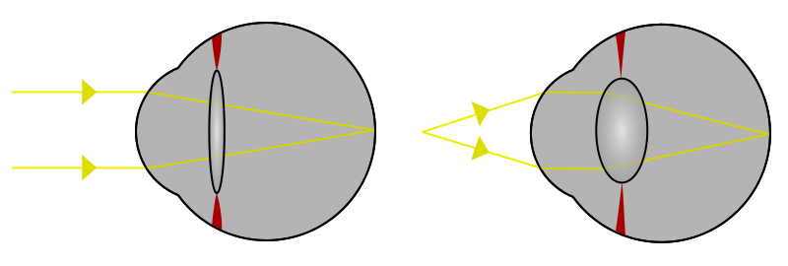
Side note about accommodation
Ability of the eye to focus by changing lens shape.
Requires two different rays from same point on object to converge on retina in different positions (be out of focus) for us to accommodate.
Human eye:
Object at infinity
Object close up
[https://en.wikipedia.org/wiki/Accommodation_reflex]
Notes:
This slide was added after the talk. The word ‘focusable’ was previously used on slide 24, which in principle is possible but in practice would result in a very low resolution display.
I’d like to thank Wolfgang Stuerzlinger at Simon Frasier University in Vancouver for the discussion after the talk on why this word probably shouldn’t have been in the previous slide as it’s a trade-off you’d probably not want to make.
Takaki nicely sums this up in his 2006 paper [1], and states (and demonstrates) that we need about 0.3-0.15 degree precision in angular rays to achieve this at viewing distance of 1-2 meters (Fig. 4) - he calls this 'super multiview'. Now, the Maimonie et al.'s Focus 3D paper [2] has a nice table to classify different display types in their typical configurations concerning accommodation (Fig. 2), and a nice paragraph in the related work about displays which support (near) correct accommodation.
Our display ppmm (pixels per millimeter) is about 6.4, with 2.5mm lenses over 45 degrees. This achieves ~3 degrees per angular ray, which given Takaki is about 10x too few to allow accommodation @ 1 meter viewing range (which is reasonable given our current pen interaction range).
One way to get closer is to reduce the lens field of view. This is what is exploited by Lanman’s Near-Eye Light Field display [3], which I mentioned I had tried and it did produce a focusing effect. In this case, the display is fixed to your head, so you only need to care about parallax from eyeball rotation – the ‘eye box’ sweet spot is very small. They claim super multiview effects: Their printed film prototypes have a ppmm of 120, which with their 1mm lenses over 17 degrees gives an angular resolution of about 0.14 degrees per angular ray. So, well meeting Takaki's numbers as the view distance is much less. This effect still worked for me with their off-the-shelf small OLED displays, too, at ~83 ppmm.
So! Given the right lens configuration, I think you _could_ produce an accommodating display with that larger-format 90 ppmm (2250 ppi on my slide) Samsung future panel that I mentioned (say 0.2 degree rays = 225 pixels per lens. Our lenses = 2.5mm diameter, so 90 ppmm needed). Just, the spatial resolution would be equivalently low to our current display - 200 x 150. Alternatively, you could reduce the output field of view (which as we discussed would be counter to the other aims of the system).
To approach 1080p spatial resolution in ~the same size screen/lens fov as ours, like I mentioned on the slide, then you'd need something 7x denser - 630 ppmm (!). This size feature is basically at the diffraction limit imposed by the lenses (1.6 micron, with diffraction limit being ~2.6-1.3 microns from red to blue). So, touch and go! I also make no claims that you could actually manufacture a large-format 630 ppmm display.
[1] Takaki, 2006, Proc. IEEE, High-Density Directional Display for Generating Natural Three-Dimensional Images http://dx.doi.org/10.1109/JPROC.2006.870684
[2] Maimonie et al., 2014, Transactions on Graphics, Focus 3D: Compressive Accommodation Display http://alumni.media.mit.edu/~dlanman/research/SIGGRAPH%202014/Focus3D_TOG_2013.pdf
[3] Lanman et al., 2013, SIGGRAPH Asia, Near-Eye Light Field Displays http://alumni.media.mit.edu/~dlanman/research/SIGGRAPH%20Asia%202013/Lanman-NELD-SA2013.pdf
Another nice diagram: http://astarmathsandphysics.com/ib-physics-notes/123-optics/1412-the-human-eye.html

Slide 26
Side note about accommodation
A focusable display allows accommodation
Requires very high angular resolution, as at least two rays from the same point on an object must both enter a single eye.
At 1-2m distance, display needs a ray every 0.3-0.15 degree.
2250ppi can give this, but at only 200 x 150 spatial resolution.
Would need ~15000dpi for 1080p, which is at diffraction limit!
See PPTX notes for more details.
Notes:
This slide was added after the talk. The word ‘focusable’ was previously used on slide 24, which in principle is possible but in practice would result in a very low resolution display.
I’d like to thank Wolfgang Stuerzlinger at Simon Frasier University in Vancouver for the discussion after the talk on why this word probably shouldn’t have been in the previous slide as it’s a trade-off you’d probably not want to make.
Takaki nicely sums this up in his 2006 paper [1], and states (and demonstrates) that we need about 0.3-0.15 degree precision in angular rays to achieve this at viewing distance of 1-2 meters (Fig. 4) - he calls this 'super multiview'. Now, the Maimonie et al.'s Focus 3D paper [2] has a nice table to classify different display types in their typical configurations concerning accommodation (Fig. 2), and a nice paragraph in the related work about displays which support (near) correct accommodation.
Our display ppmm (pixels per millimeter) is about 6.4, with 2.5mm lenses over 45 degrees. This achieves ~3 degrees per angular ray, which given Takaki is about 10x too few to allow accommodation @ 1 meter viewing range (which is reasonable given our current pen interaction range).
One way to get closer is to reduce the lens field of view. This is what is exploited by Lanman’s Near-Eye Light Field display [3], which I mentioned I had tried and it did produce a focusing effect. In this case, the display is fixed to your head, so you only need to care about parallax from eyeball rotation – the ‘eye box’ sweet spot is very small. They claim super multiview effects: Their printed film prototypes have a ppmm of 120, which with their 1mm lenses over 17 degrees gives an angular resolution of about 0.14 degrees per angular ray. So, well meeting Takaki's numbers as the view distance is much less. This effect still worked for me with their off-the-shelf small OLED displays, too, at ~83 ppmm.
So! Given the right lens configuration, I think you _could_ produce an accommodating display with that larger-format 90 ppmm (2250 ppi on my slide) Samsung future panel that I mentioned (say 0.2 degree rays = 225 pixels per lens. Our lenses = 2.5mm diameter, so 90 ppmm needed). Just, the spatial resolution would be equivalently low to our current display - 200 x 150. Alternatively, you could reduce the output field of view (which as we discussed would be counter to the other aims of the system).
To approach 1080p spatial resolution in ~the same size screen/lens fov as ours, like I mentioned on the slide, then you'd need something 7x denser - 630 ppmm (!). This size feature is basically at the diffraction limit imposed by the lenses (1.6 micron, with diffraction limit being ~2.6-1.3 microns from red to blue). So, touch and go! I also make no claims that you could actually manufacture a large-format 630 ppmm display.
[1] Takaki, 2006, Proc. IEEE, High-Density Directional Display for Generating Natural Three-Dimensional Images http://dx.doi.org/10.1109/JPROC.2006.870684
[2] Maimonie et al., 2014, Transactions on Graphics, Focus 3D: Compressive Accommodation Display http://alumni.media.mit.edu/~dlanman/research/SIGGRAPH%202014/Focus3D_TOG_2013.pdf
[3] Lanman et al., 2013, SIGGRAPH Asia, Near-Eye Light Field Displays http://alumni.media.mit.edu/~dlanman/research/SIGGRAPH%20Asia%202013/Lanman-NELD-SA2013.pdf
Another nice diagram: http://astarmathsandphysics.com/ib-physics-notes/123-optics/1412-the-human-eye.html

Slide 27
This is our focus.
What about interaction?
How can we interact in
light field space?
Notes:
But what about interaction?
This 4D light field space allows us to realistically view 3D objects, but how can we interact with this 3D space?
This is the focus of our work.
// We could couple an existing 3D tracking system, and there are positives and negatives there which we go through in the paper, but is there a way to exploit the lenslet array that we’re using for display to achieve this?

Slide 28
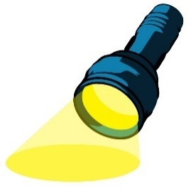
Reverse the ray direction!
Lenslet array
Sensing pixel array
Notes:
Well, if we have sensing pixels behind our lenslet array instead of display pixels, then we could simply reversed the ray directions back to the scene and analyze it for interaction control.
Flashlight:
http://vlab.ethz.ch/flashlight/images/flashlight.jpg

Slide 29
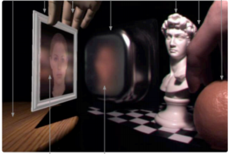
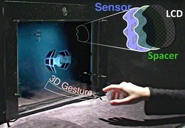
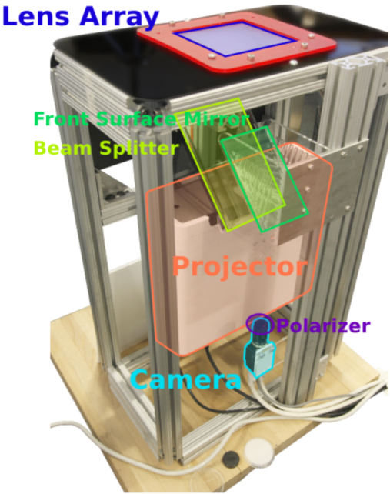
Previous work
Cossairt et al., 2008
Light Field Transfer
Between synthetic and real objects
Hirsch et al., 2011
BiDi Screen
2D display
Light field sensing
Hirsch et al., 2013
8D Display
Light field display
Light field sensing via direct illum. transfer
Notes:
The inspiring previous work in this area covers different ways to build these joint or bi-directional displays, using beamsplitters, or phase separation, Their interactions focus on illumination transfer, such as relighting of scenes, or they achieve low-speed low-precision gestural control.
In this in-air freeform interaction setting, the human hand can move very quickly, or if it is still, with very little jitter.
Light Field Transfer: http://www.cs.columbia.edu/CAVE/projects/lightfield_transfer/
BiDi Screen: http://alumni.media.mit.edu/~mhirsch/bidi/
8D Display: http://alumni.media.mit.edu/~mhirsch/8D/

Slide 30
Fast High accuracy High precision Light field input
Notes:
What we really want is very fast, high accuracy, and high precision light field input – this is our goal.
We’re going to do this with an optical pen. Let’s look at our hardware design.
6 minutes 30 seconds

Slide 31
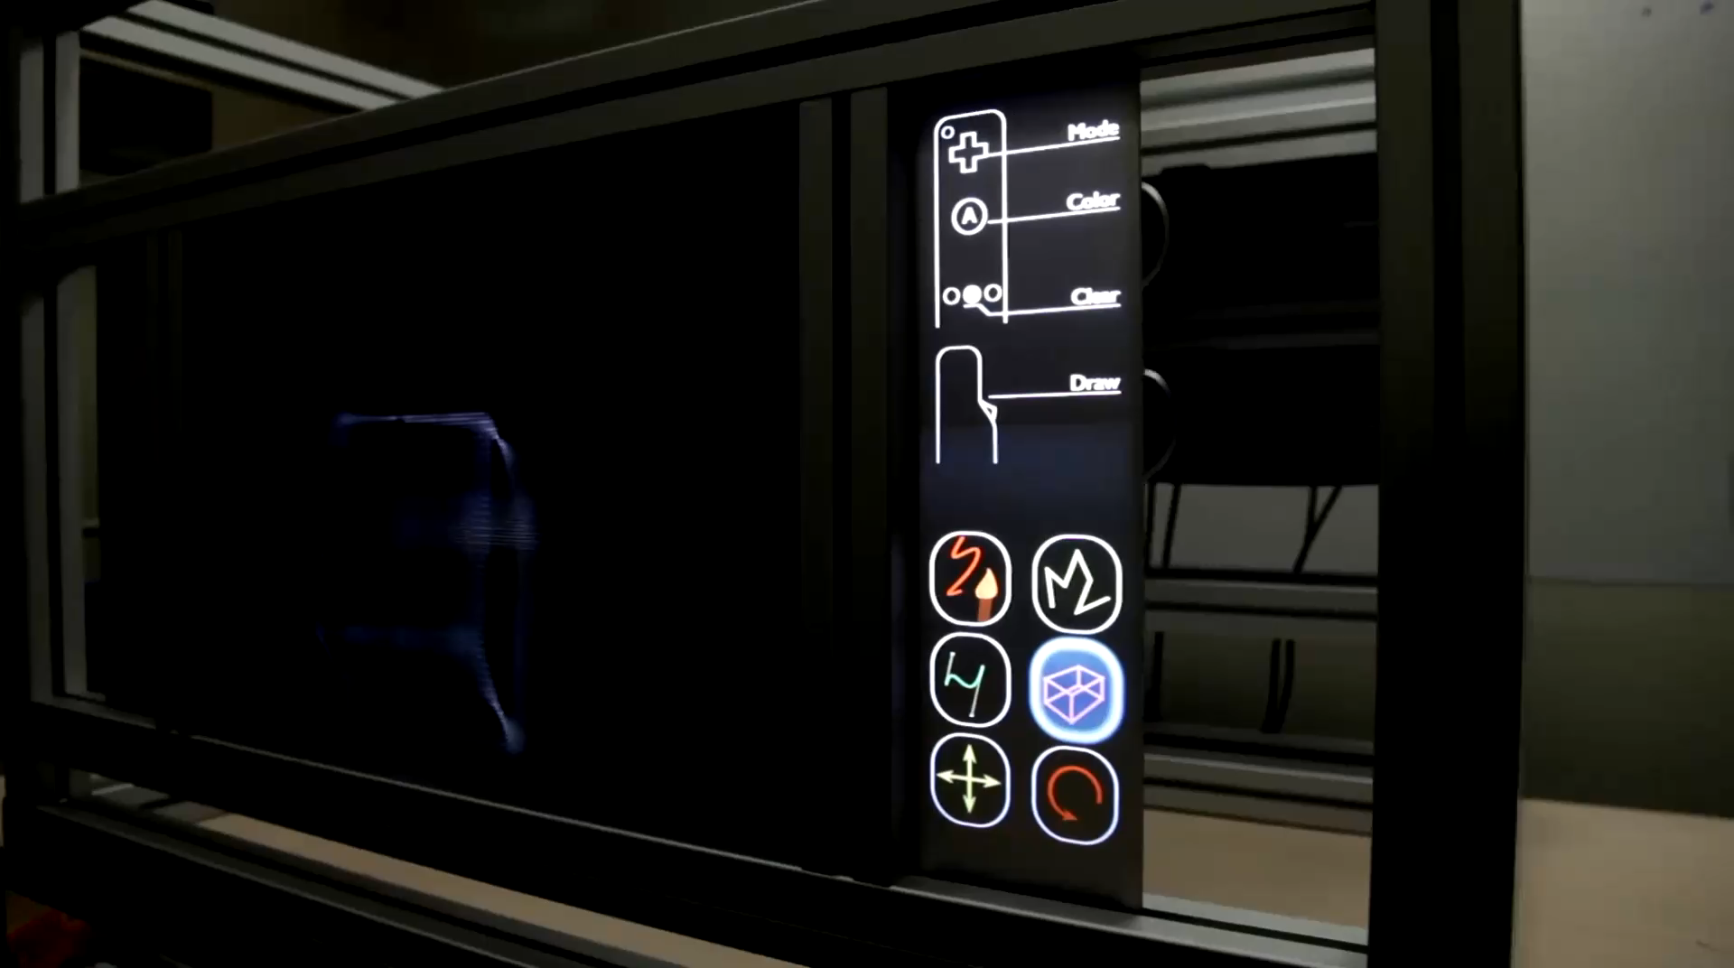
2D side display
for info + text
Lenslet array
Notes:
At the front we have a <ADVANCE> lenslet array for our many views, and to the side we have a <ADVANCE> 2D display for high-res info and text. <ADVANCE> <ADVANCE>

Slide 32
Notes:
At the back there we have 4 projects to cram as many display pixels as we can behind our lenslet array. And there is an infrared camera, which images an infrared pen – just a simple LED – through the lenslet array. That’s it.
If we flip that around, you can see the image multiplexed onto a diffuser on the back of the lenslet array.
The projector, camera, and lenslet array all need to be calibrated so that they exist in a shared space.
I’m not going to explain it now, but our calibration process gives us, <ADVANCE>

Slide 33


Calibration LUT
Green/red = theta/phi ray angle.
Notes:
…for each display and sensing pixel, a look-up table into ray space.
The honeycomb pattern arises from the hexagonal arrangements of lenslets.

Slide 34

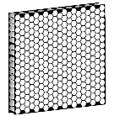
What the IR camera sees
Lenslet array
Notes:
What the IR camera sees of the pen is many tiny images of the varying angles of the LED pen.
Because we know we are looking for a single point, we can directly attempt to estimate the most prominent ray direction for each lenslet from this image.
Even though these light cone images are small, we can exploit the massive redundancy from the slight shift in viewpoint to achieve high precision.

Slide 35
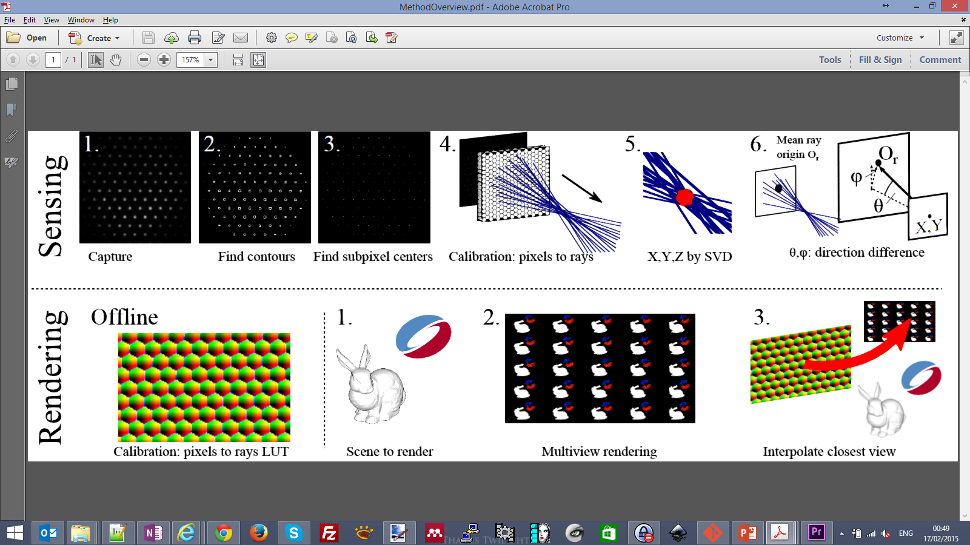
Sensing pre-process
Notes:
Given an image from the camera, we find the contours of each of these blobs, then find the brightness-weighted center to subpixel accuracy.

Slide 36
Sensing position
LUT
Notes:
Then, we go back to our look-up table and, for each subpixel, estimate a corresponding ray.
The convergence of these rays in space is the position of the pen in 3D, which is a least-squares problem we can solve with singular value decomposition.

Slide 37
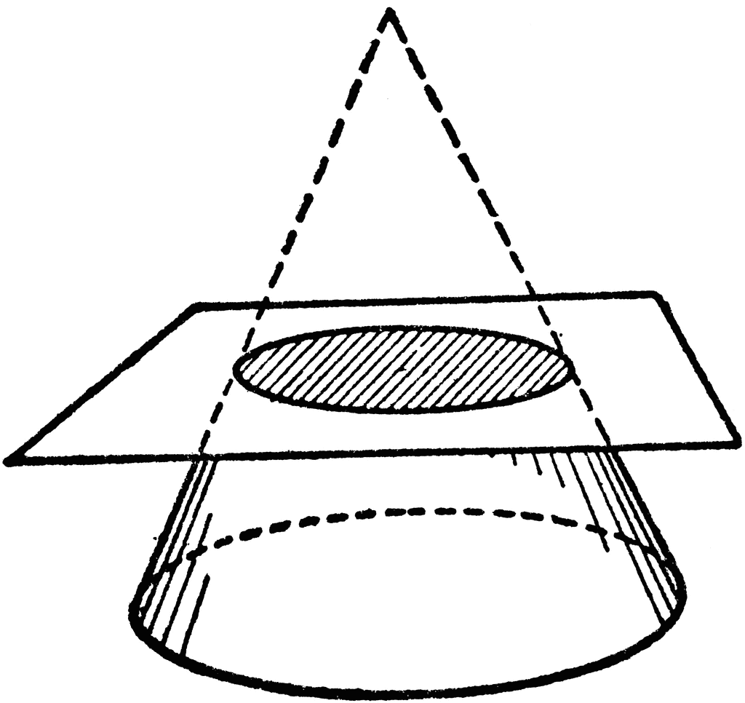
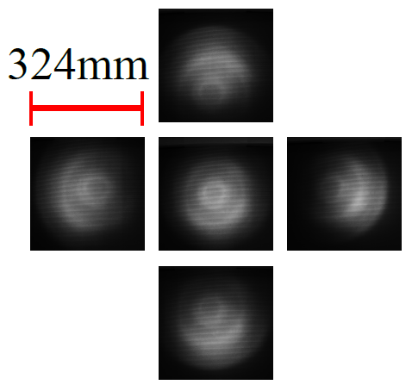
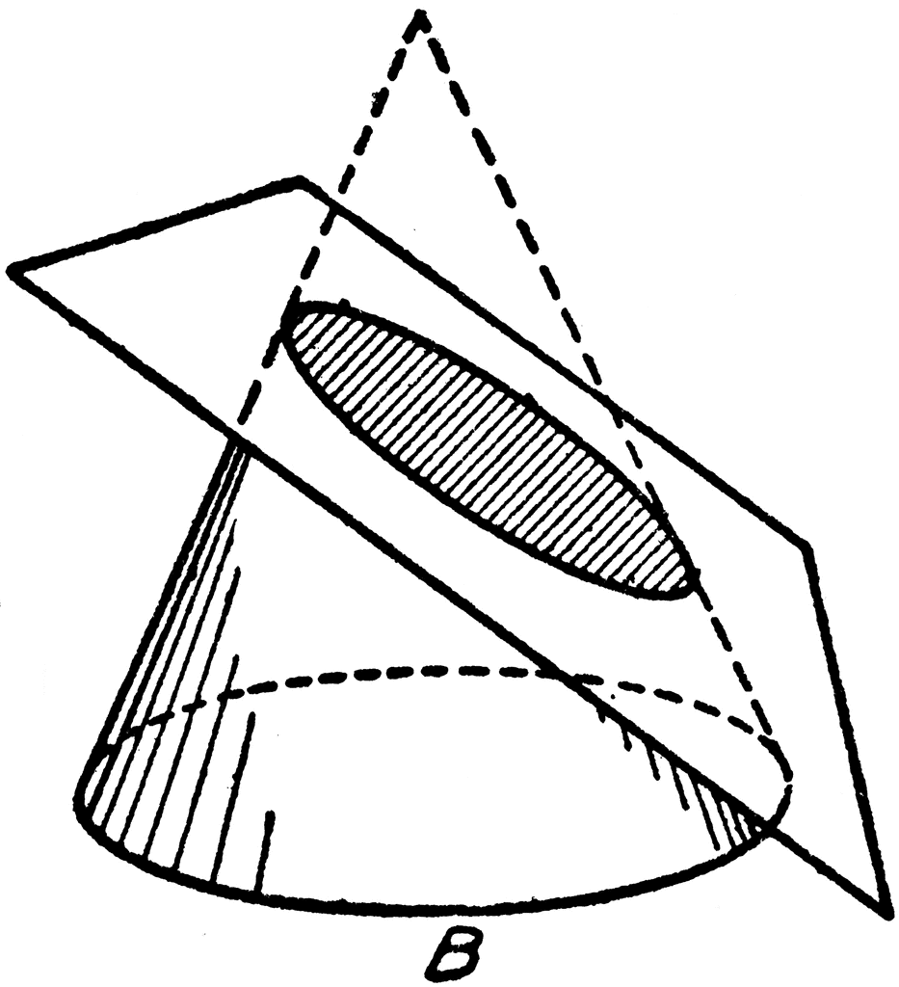
Sensing orientation
Tilt up
Pan left
Pan right
Tilt down
Notes:
This doesn’t give us orientation, but another cue does.
We can consider the pattern across all lenslets as a whole, and think about the lenslet array as cutting the cone of light emitted from the LED at different angles.
<ADVANCE>
You can see this here as I vary the horizontal and vertical angle of the pen.
Given this idea, then the pen direction can be computed by simple trigonometry from is cross section.

Slide 38
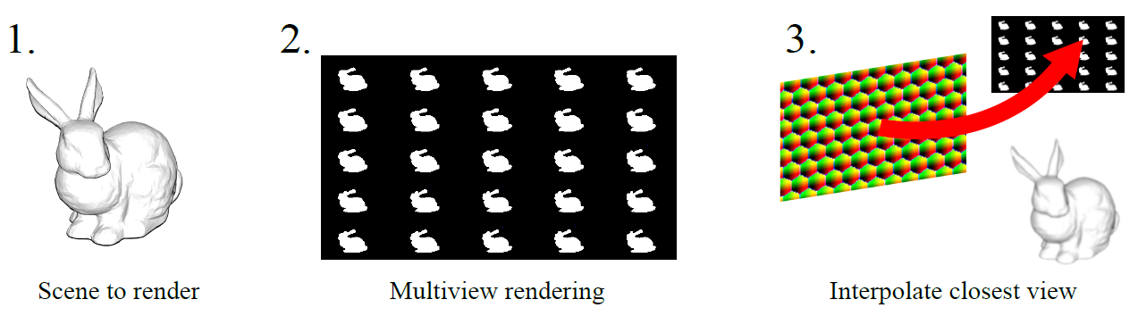
Rendering
Notes:
To render, we simply reverse the process.
Given a 3D scene representation, we draw it many times from different angles. Then, for each LUT pixel, we find the nearest angle among the rendered views and assign the pixel color.

Slide 39

Notes:
Here’s the system working with a simple IR LED pen.
We achieve accuracy of about 2-3 millimeters and 2 degrees, and precision of .4 millimeters and .3 degrees.
We can do this very fast – about 6-7ms or ~150Hz on our 2012 hardware.
Now, just to get some wireless buttons, we embed this IR LED into a Wiimote, but we don’t use any of the sensors on it at all.
Here we can see the x,y,z and pan/tilt readout, and as we can do this very quickly then we can cope very well with rapid hand movements.

Slide 40
Range: Cheating depth of field
Depth of field: Range of sharp image reproduction.
Our display: ±50 mm
Blurred sensing: No problem! Easy to find center of blurred circle.
Sensing range: 0-350mm – 7x larger.
Notes:
One final point about the sensing, and it’s to do with range.
With any lens system, like our display, we have a depth of field – this is the range in which virtual objects produce a sharp image. For us, this is about 50mm in front and behind the focal plane (the back of the lenslet array). Of course, you can view them from any distance.
Beyond this, the display blurs. Equivalently, the sensing blurs. However, as we know we’re looking for an approximate point, well, this is no problem. It’s easy to find the center of a blurred circle accurately. <ADVANCE> This allows us to significantly extend the range – out to 350mm.
So there we go!
Now we have a general purpose light field input device.

Slide 41
Painting application
Notes:
So what could you do with such an input device?

Slide 42
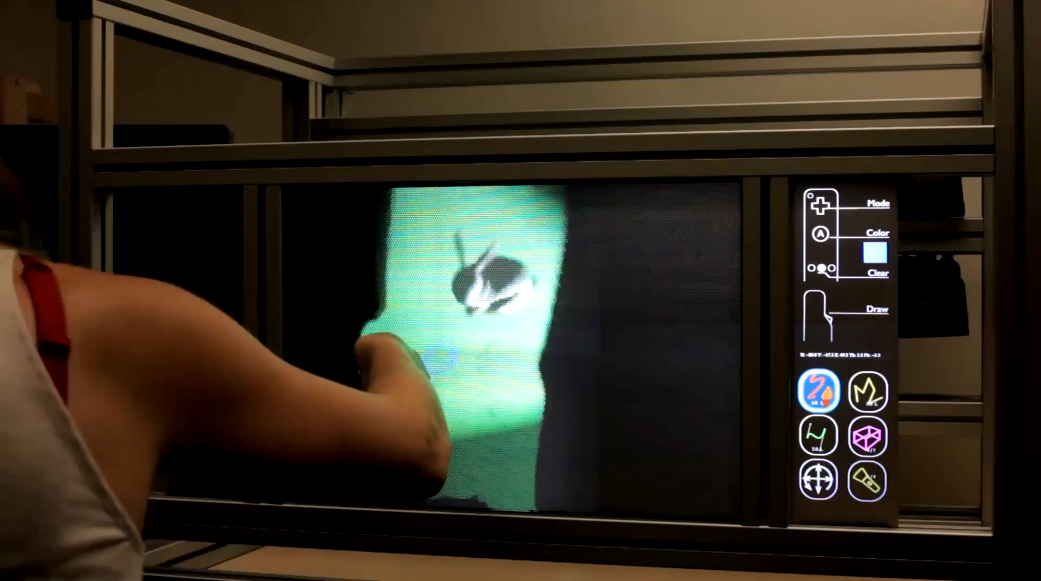
Notes:
Let’s draw a flower in Z, then rotate it to see the effect<ADVANCE>

Slide 43
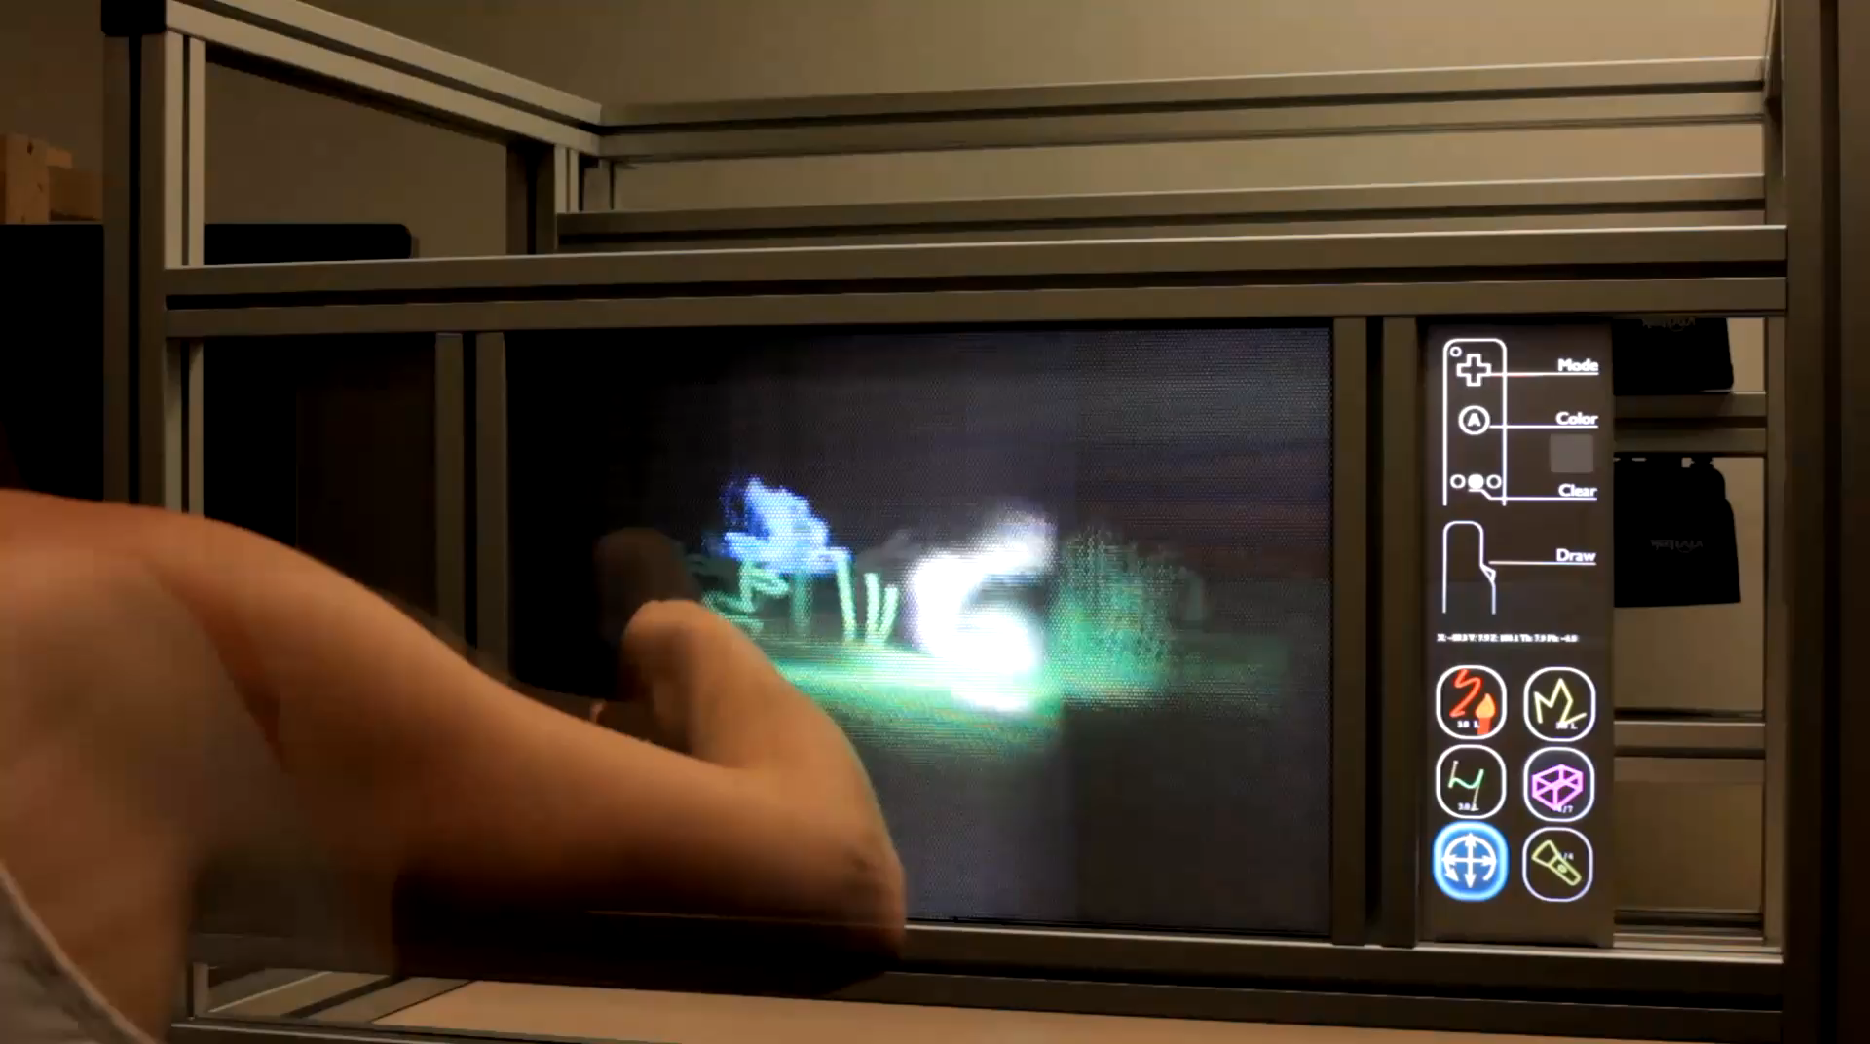
Notes:
…or to use different tools like curves, lines, and primitives in 3D to build up a scene, light the scene, and throughout these interactions also view the scene in 3D.

Slide 44

Notes:
Let’s do virtual lighting with handheld flashlights.
You just place the flashlight directly where you want it and in right direction.
Because this is now a virtual light, we can change the color or cone, and add as many lights as we wish.
The camera here has a bit of trouble capturing the dynamic range in this shot; sorry about that. The scrolling colored lines are also a DLP project/camera synchronization issue, and they don’t appear to the eye on the real display.

Slide 45
Two more tricks
Notes:
So what other tricks do I have in my bag here?

Slide 46
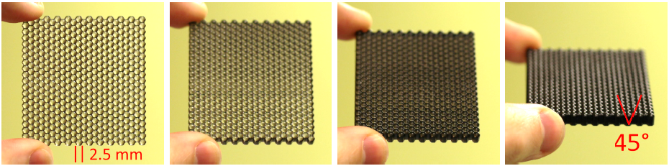
Lenslet array
200 x 150 lenses
2.5 mm across
3mm focal length
15 x 15 pixels behind each lens
45° field of view
Small sample of larger sheet
Notes:
First trick: Hitting a sweet spot for the spatio-angular trade-off requires a specific lens size, and finding a manufacturer is hard because lenslet arrays are typically made with diamond-cut molds.
Instead, we 3D printed this lenslet sheet. It’s 500 mm by 350 mm, and contains 200 x 150 lenses, so that’s our spatial resolution, which is pretty low.
Each lens has about 15 x 15 pixels behind it, so that’s our angular resolution, which is pretty high.

Slide 47
Lenslet array – Integrated baffles
[Tompkin et al., Content-adaptive Lenticular Prints, SIGGRAPH 2013]
Notes:
Now, when you move outside the field of view in traditional lenslet arrays, the image starts to ghost due to cross talk from refractions. With multi-material 3D printing, we can reduce this by printing tiny baffles between the lenses – little black walls which block light at off angles to improve image quality.
If you want to see this in person, then I have this sample with me; just come up at the end.

Slide 48

Extending interaction space
-50mm
+50mm
Notes:
Second trick: Remember when I talked about the depth of field of the display as being plus-_minus_ 50mm? Why minus? Well, in ray space, the light still converges behind the lenslet array <ADVANCE>, so there’s no particular reason why we can’t draw _behind_ the physical lenslet array in virtual space.

Slide 49
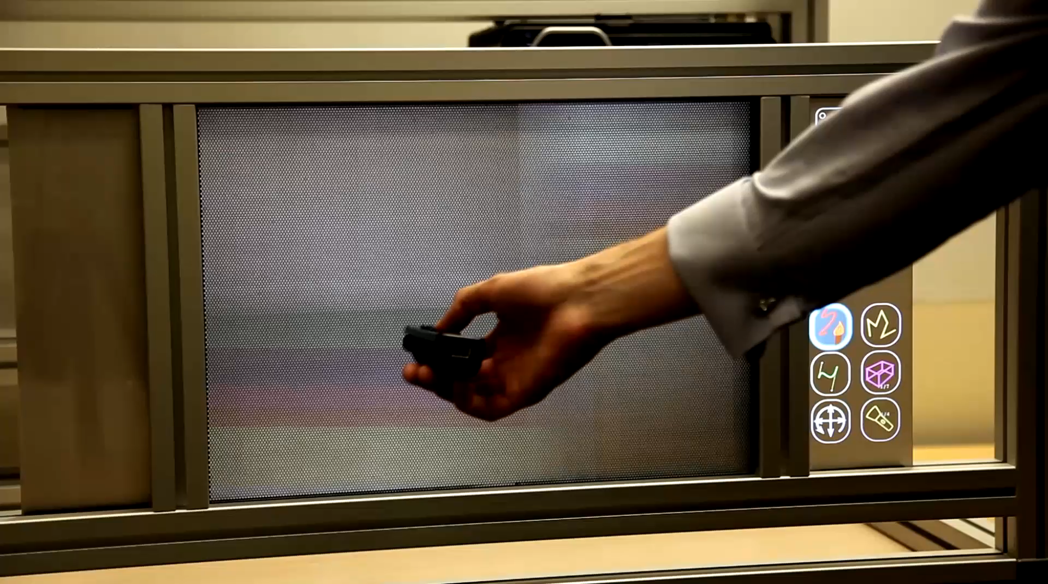
Extending interaction space
Notes:
But, we can’t physically put the pen behind the lenslet array because it’s a sheet of plastic.
To overcome this, we relay the light field space.

Slide 50
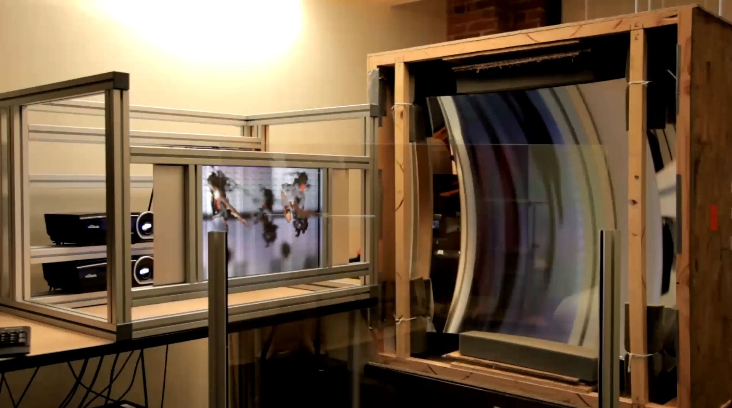
Optical relay
Notes:
This is an optical relay formed from a beam splitter and a spherical mirror. It rotates the light field by 90 degrees.
To demonstrate how this helps, I’m going to slice the light field with a piece of paper. Here’s a slightly rotated view.
When the image on the paper is most in focus, we’re equivalently at the lenslet array.
Beyond this, like so, we’re extending the interaction space behind the lenslet array.
So now, we’ve removed the physical restriction, and the pen can move into _negative_ Z space.

Slide 51
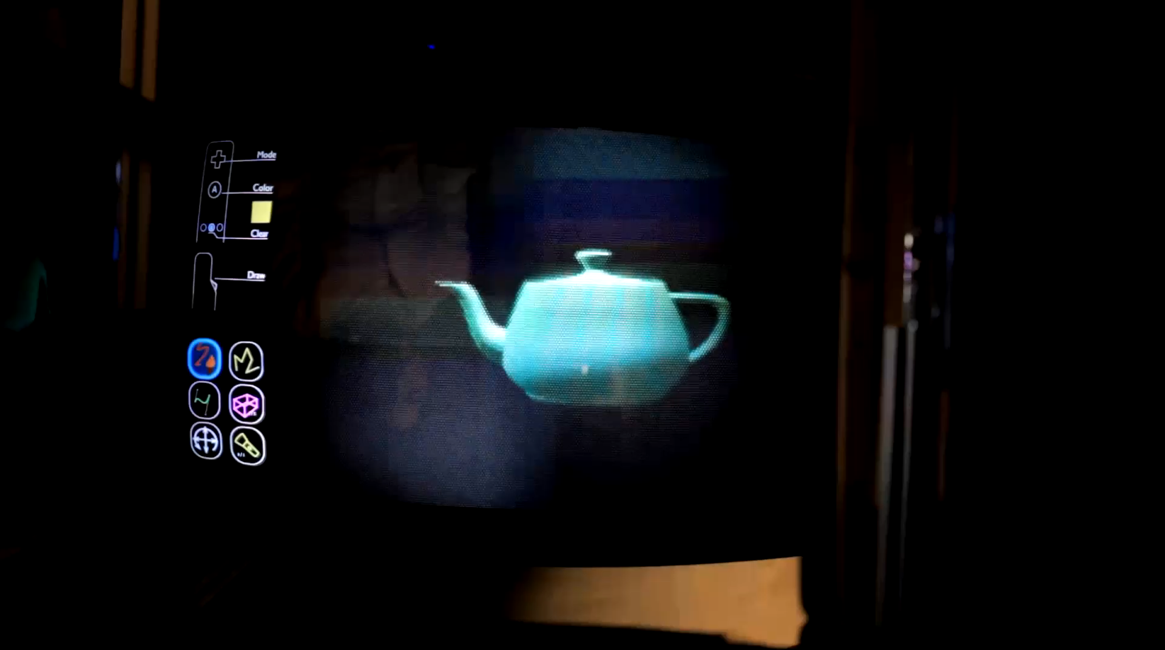
Extending interaction space
Notes:
So, of course, now we can draw behind objects that are at the focal plane.

Slide 52
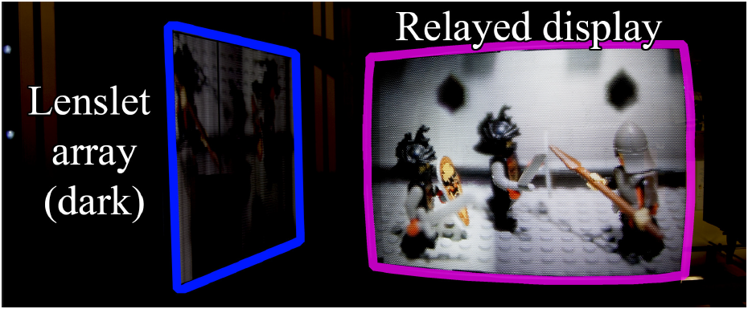
Optical relay + baffles
Notes:
One nice side effect of the baffles in this case is that, as we’re now at 90 degrees to them, the original display is automatically darkened.

Slide 53
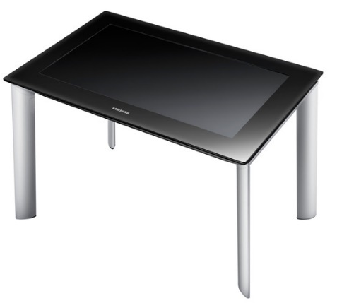
Limitations
Spatio-angular trade-off
…but our friend will fix this by 2020 ; )
Projector/camera ‘bulk’
New subpixel – R,G,B, IR in
Like SUR40
Display depth of field
…but robustness to blur extends interaction space by 7x
Pen roll – future work: non-symmetric light cone.
Notes:
What are the major limitations?
Well, as we said, the spatio-angular trade-off is a big problem – our display is very low spatial resolution.
But, very high PPI displays over the next 5 years will fundamentally fix this.
The next problem is the ‘bulk’ of the projector/camera system. What we really want is a fourth subpixel along with R,G,B, which senses instead of displays. Microsoft and Samsung previously built something like this for 2D touch – the SUR40 – in principle, you could put our lenslet sheet over that display and achieve what we show here.
The increased pixel density also improves the display depth of field – and as stated, our sensing approach already increases this for interaction because it is robust to blur.
Finally, we’re missing pen roll – but we think you can probably do this with a non-symmetric light cone.
SUR40 image:
http://cdn2.sbnation.com/products/large/3388/done-samsung-sur40.jpg?1318534551

Slide 54
Conclusions
Joint optical path for light field input and output
Reciprocity: See where you draw in 3D Draw where you see in 3D
IR pen sensing @ 150 Hz
3D position – 0.2-0.3 mm precision, 2-3mm accuracy
2D pan/tilt – 0.2-0.3° precision, 2-3° accuracy
0-350 mm range within 50° FOV
Precision equal to human hand jitter
Two tricks: Extending interaction with optical relay Printing lenses with baffles
Notes:
To conclude, there is value in exploiting a joint optical path for input and output, as this reciprocity allows you to see where you draw in 3D, and also draw where you see in 3D.
This interaction is achieved with very fast IR pen sensing, with good accuracy and precision, where the precision is equal to the human hand jitter.
I also showed two tricks that can improve the system – how we can extend the interaction range, and how baffles can reduce cross talk and interplay with the relay.

Slide 55
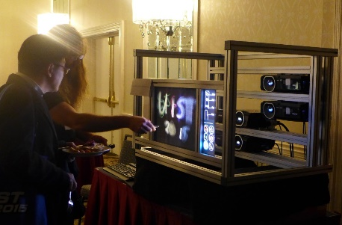
Acknowledgements
Olivier Bau, Daniel Haehn, Xavier Snelgrove, Stanislav Jakuscievski, Maryam Pashkam, Ken Nakayama, Lara Booth.
Datasets: (New) Stanford Light Field Archive, Stanford 3D Scanning Repository, and I-R Entertainment Ltd., Morgan McGuire, and Guedis Cardenas.
Grants: ERC-2010-StG 259550 (“XSHAPE”), NSF CGV-1110955.
Everyone who came to the demo ; )

Slide 56
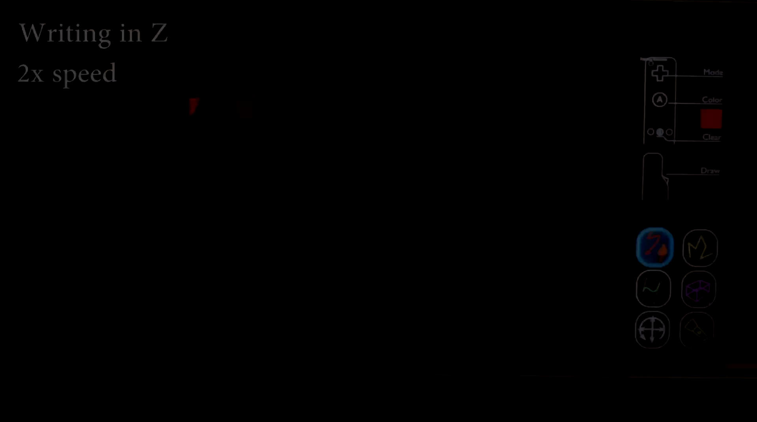
Joint 5D Pen Input for Light Field Displays
James Tompkin, Samuel Muff, James McCann,
Hanspeter Pfister, Jan Kautz, Marc Alexa, Wojciech Matusik
Thank you - questions?
Notes:
I’ll leave you with our final example – instead of writing in X and Y, we’re going to write in Y and Z to show the quality of our sensing. Rotating the scene reveals the message.
<ADVANCE>
Thank you very much!

Slide 57
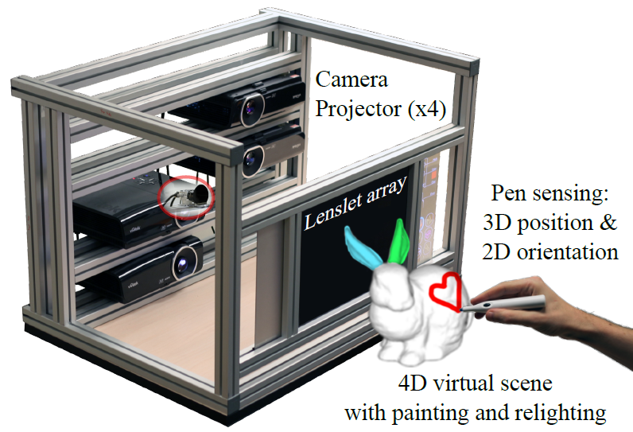
Notes:
At the back there we have 4 projects to cram as many display pixels as we can behind our lenslet array, which is at the front of the display in black. Also at the back there is an infrared camera, which images an infrared pen – just a simple LED – through the lenslet array. That’s it.
From this, we’re able to produce light field scenes, and also detect the 3D position and 2D orientation of the pen.

Slide 58
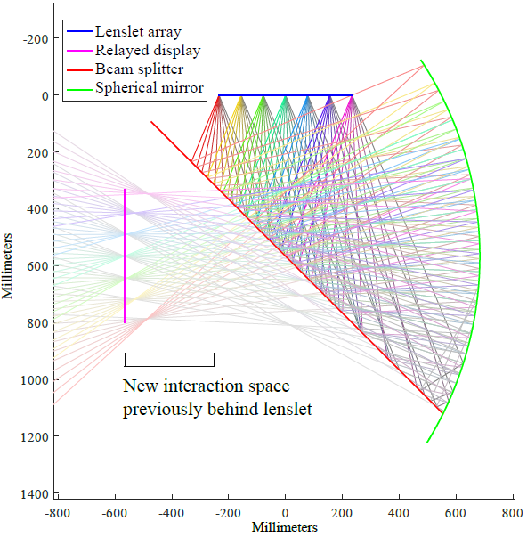
Optical relay

Slide 59
Lens
width

Slide 60
Lenses, baby, lenses
Number of views?
Spatial resolution?
Pixels

Slide 61
Lenses, baby, lenses
Number of views?
Spatial resolution?
Pixels

Slide 62
Lenses, baby, lenses
Number of views?
Spatial resolution?
Pixels

Slide 63
Lenses, baby, lenses
Number of views?
Spatial resolution?
Pixels

Slide 64
Why 4 projectors?
Number of views?
Spatial resolution?
Number of views?
Spatial resolution?

