Slide 1
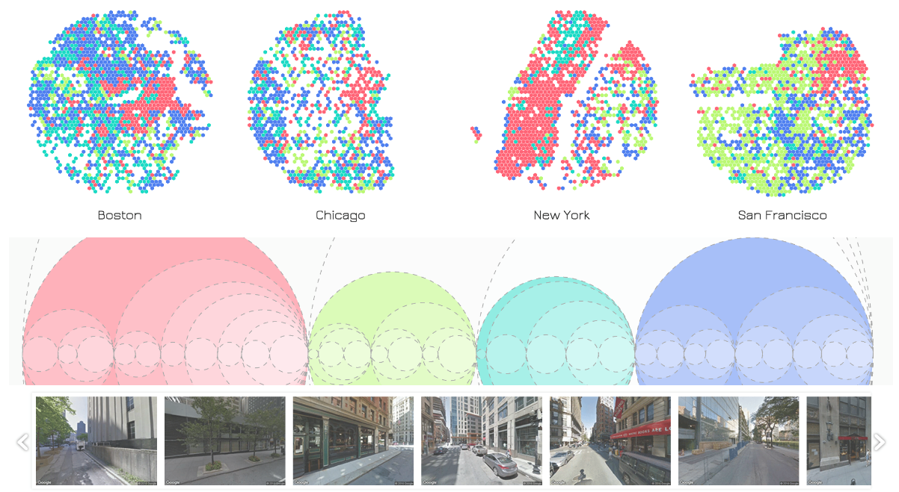
Visual Analytics and Deep Learning for City Street View Datasets
Exploring Perspective Neighborhoods -
Lezhi Li | lezhi.li@uber.com |||James Tompkin | james_tompkin@brown.edu
Panagiotis Michalatos | pmichala@gsd.harvard.edu ||| Hanspeter Pfister | pfister@seas.harvard.edu

Slide 2
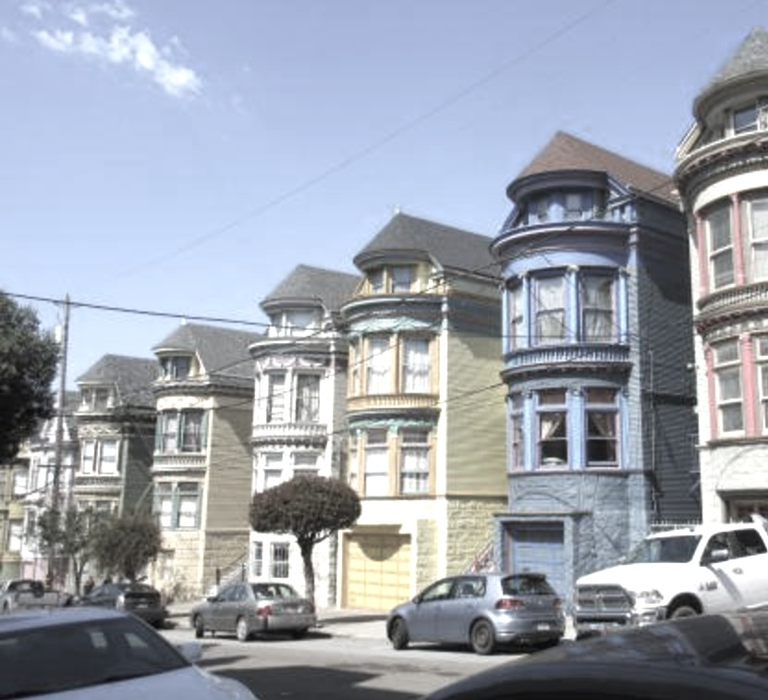
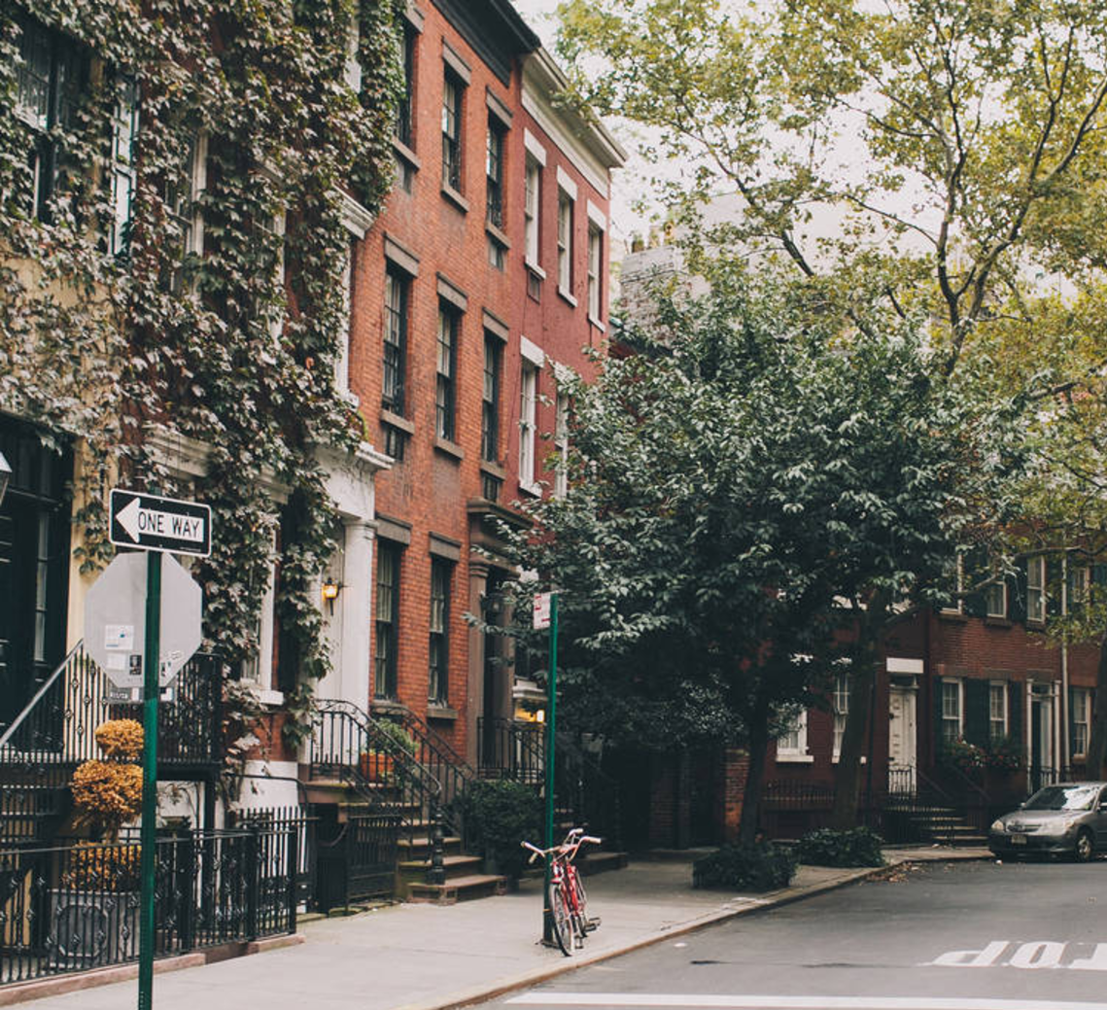
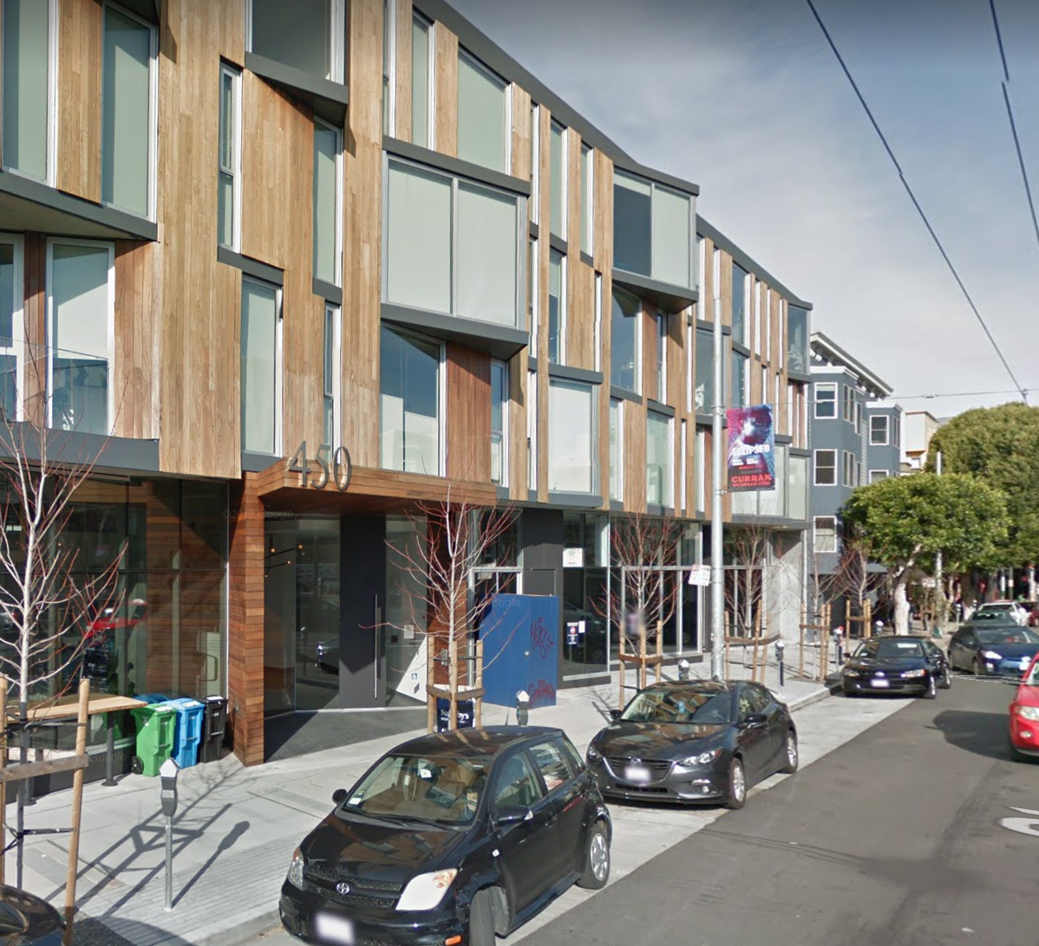
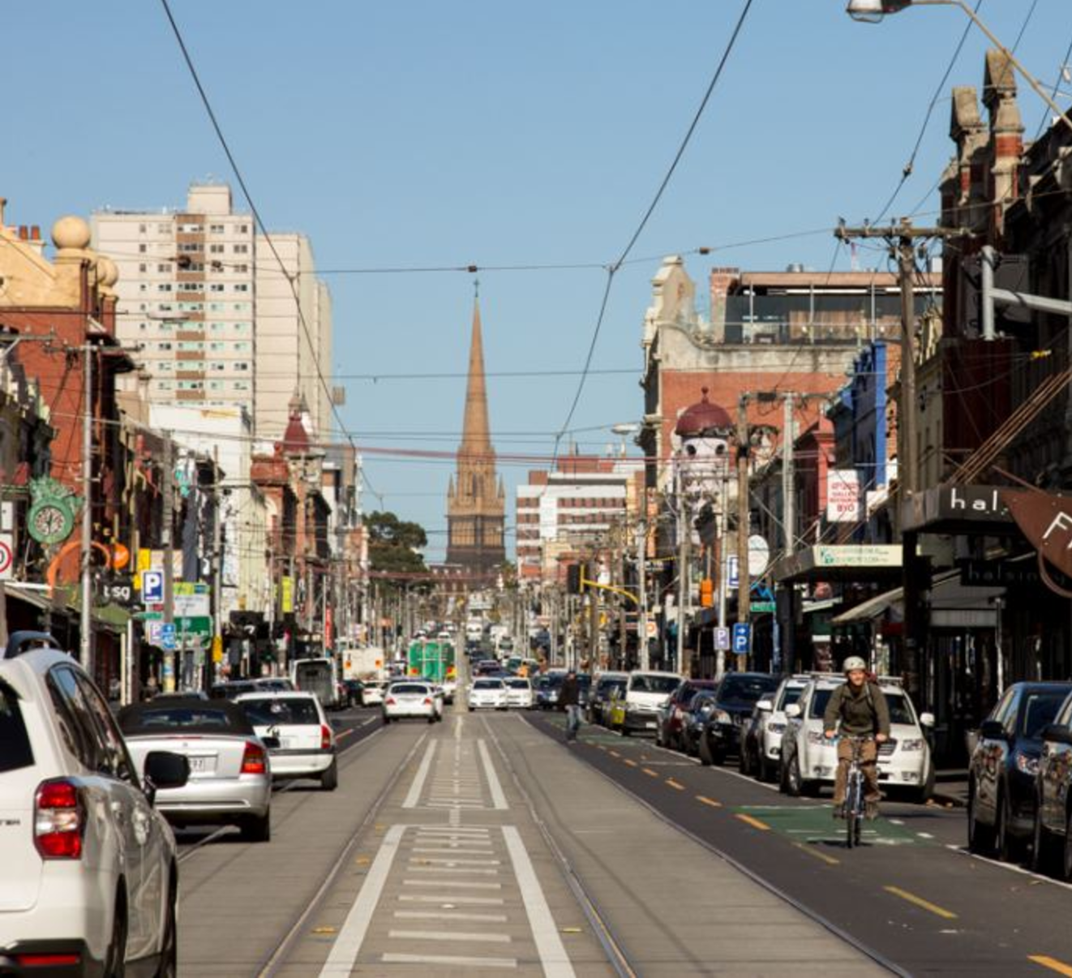
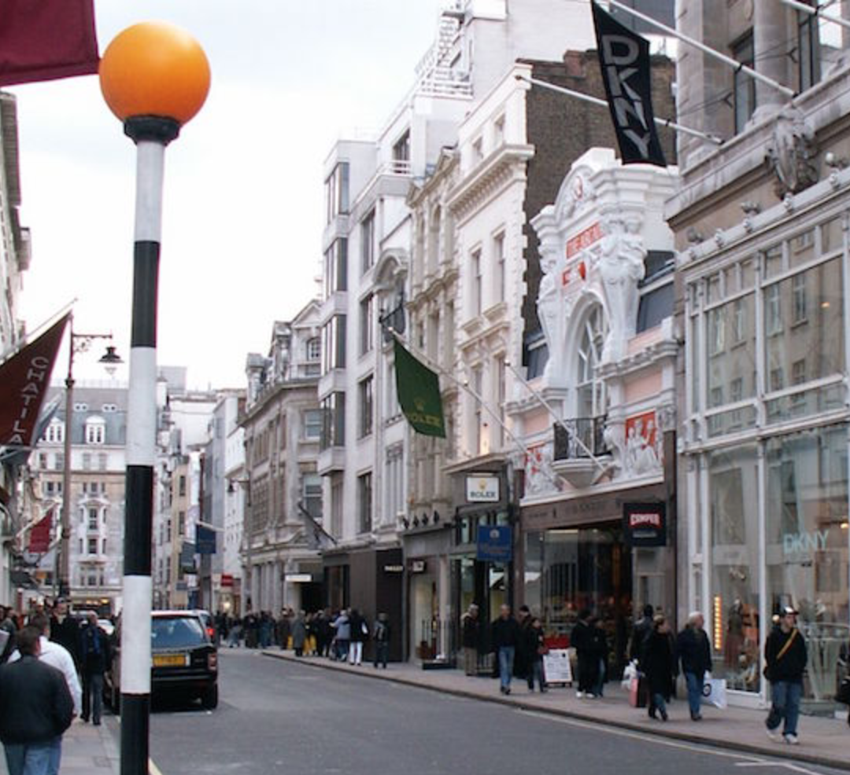
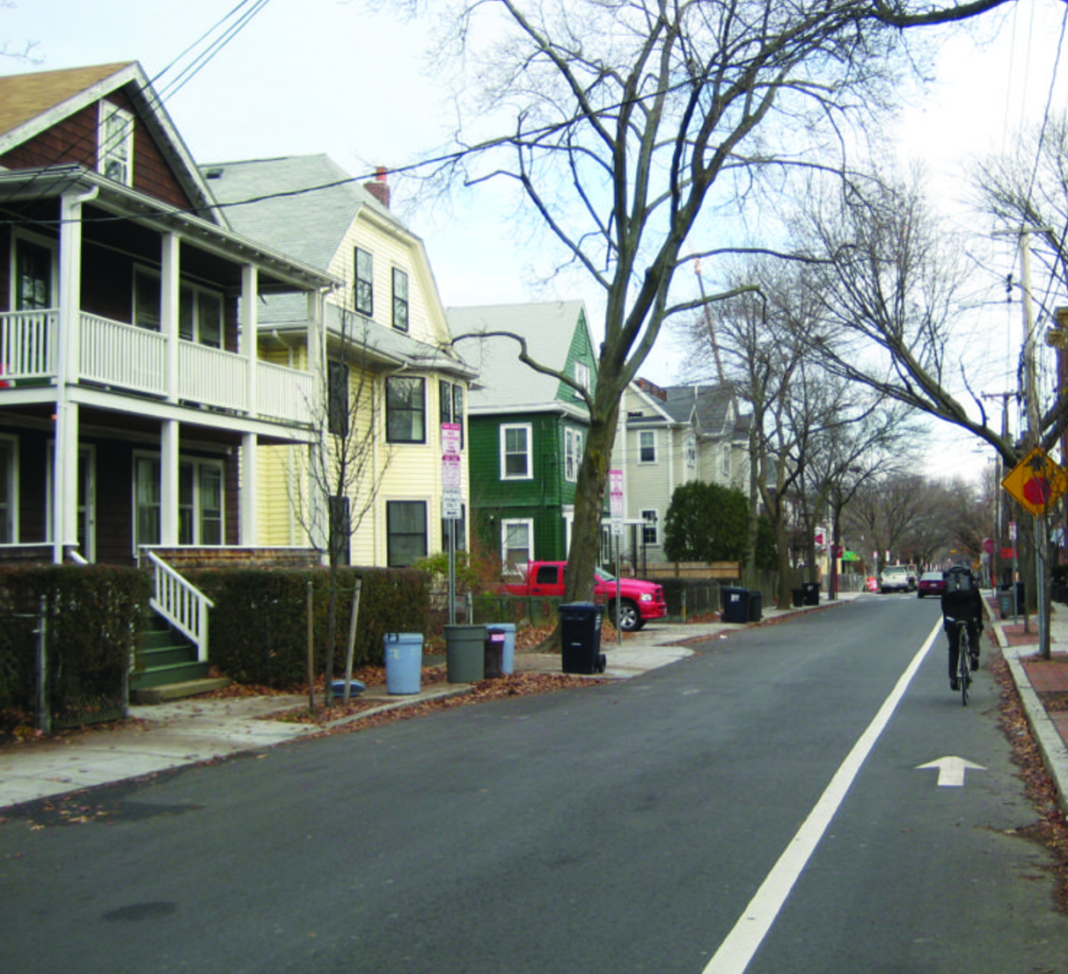
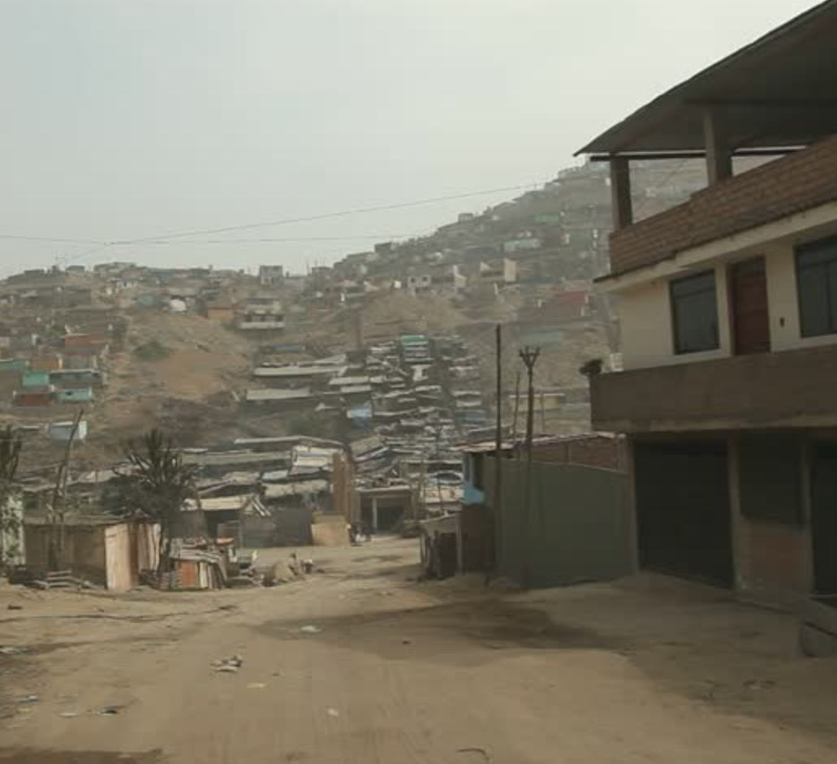
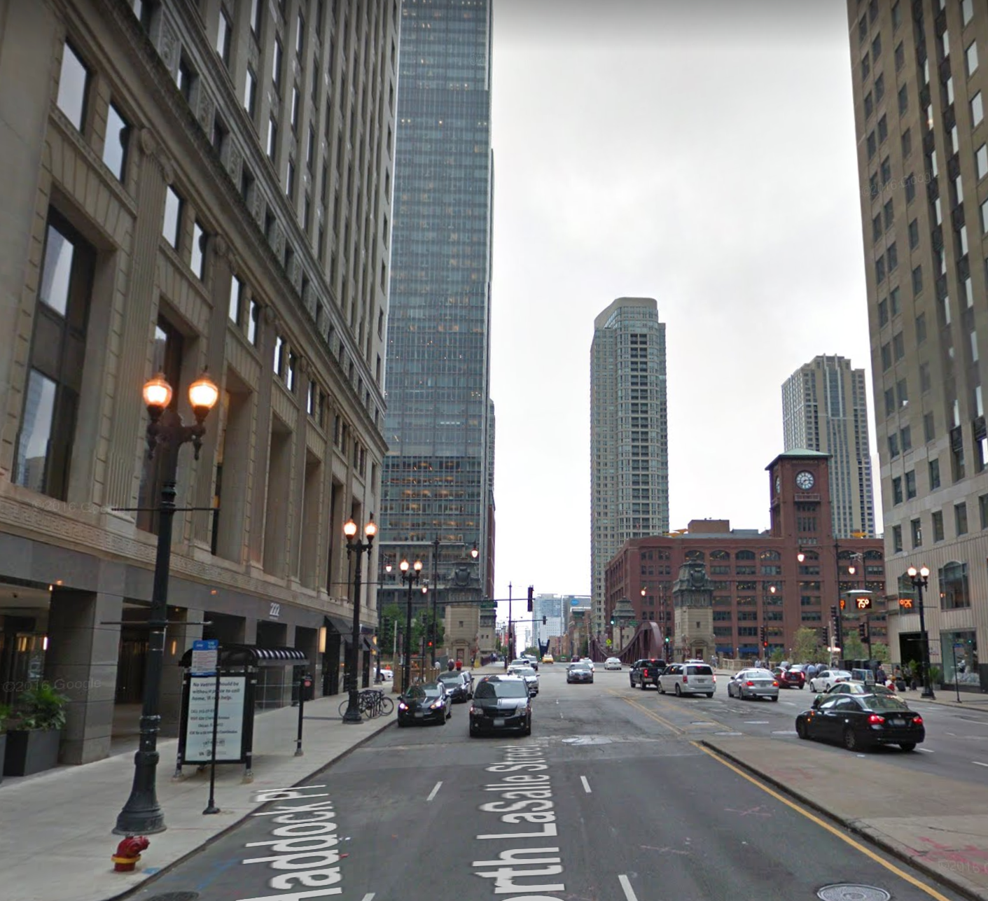
Visual characteristics of cities provide rich insights into the locality:
functions
demographics
affluence
history
…
The information is useful for city residents and urban researchers alike, E.G:
residents: find a place for housing
researchers: comparing the spatial distribution of residential v.s. industrial areas among cities
Notes:
As a first-time visitor to a city, walking in the streets and seeing the visual characteristics of the neighborhoods provides rich insights into local functions, demographics, affluence, and history. This visual information is useful..

Slide 3
Digitizing visual characteristics analysis
Current approach
Datasets already exist (e.g., Google Street View), but insight generation is slow.
Our approach
Combine deep learning and visualization to help consume, query, and analyze geographically-located image data.
Automatically identifying “perspective neighborhoods” (urban areas with shared visual characteristics) based on image features.
Notes:
Thanks to pervasive city imagery datasets such as Google Street View, we are now equipped with tools to virtually explore cities and obtain similar knowledge. However, virtually walking the streets to generate insight is still slow.
As such, we present an application of city street-level image datasets for the systematic study of urban visual environments.
We combine machine learning and data visualization, to help consume, query, and analyze geographically-located image data.
We focus on how urban areas with shared visual characteristics (“perspective neighborhoods”) can be automatically identified based on their visual features.

Slide 4
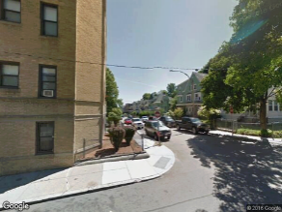
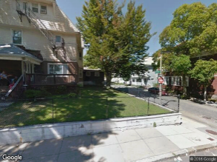
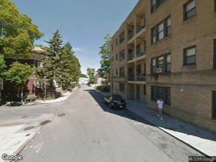
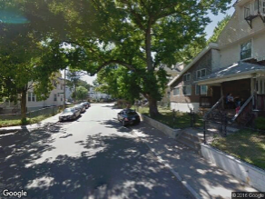
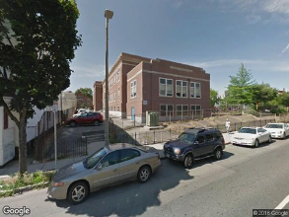
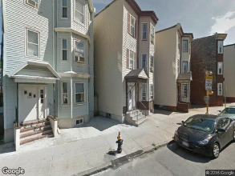
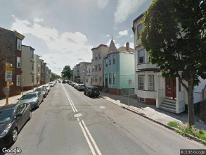
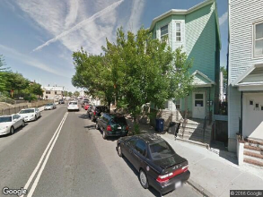
Data Collection
Boston, Chicago, New York, San Francisco
100,000+ images (25,000+ for each city)
Images are extracted on a grid within a 6 km radius; 4 directions for each point.
6 km
Notes:
Using Google Street View API, we densely sampled four cities in the United States: Boston, Chicago, New York, and San Francisco. Over 100,000 images were collected on a grid, and at each grid point we requested for images from 4 directions.

Slide 5
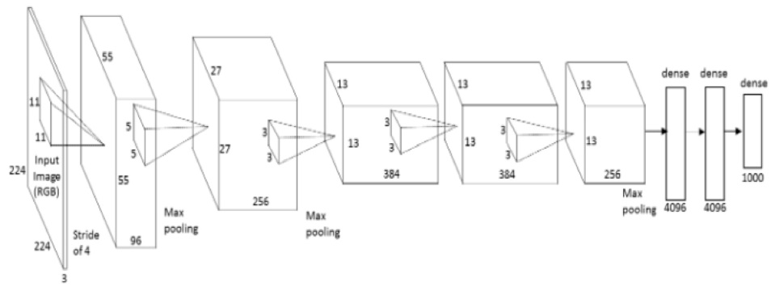
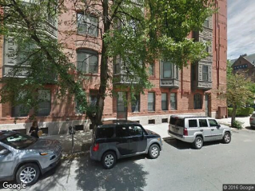
Training a Neural Net
“Beacon Hill”
“Beacon Hill”
Image + Label
Features
Predicted label
2/3 training, 1/6 validation, 1/6 testing random split
Training target: Neighborhood Name (from Zillow neighborhood boundary data)
AlexNet architcture (with modified output layer)
MatConvNet framework
Notes:
With this dataset, we trained a CNN to predict neighborhood names based on image contents. We used a model structure similar to AlexNet, trained it with the MatConvNet framework.

Slide 6
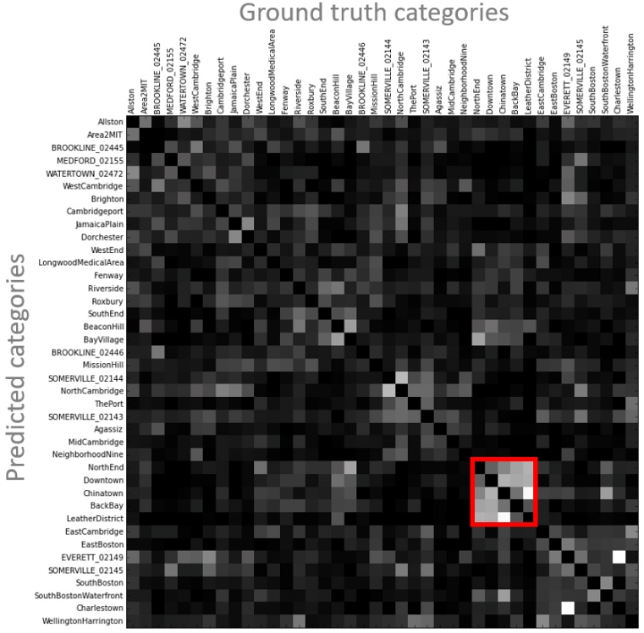
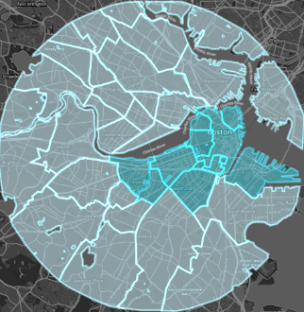
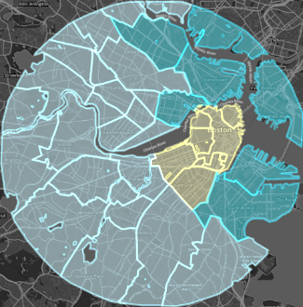
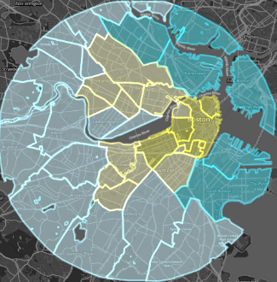
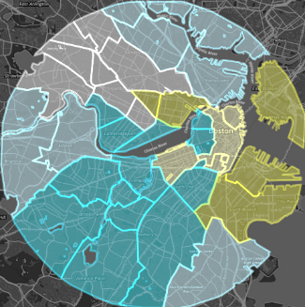
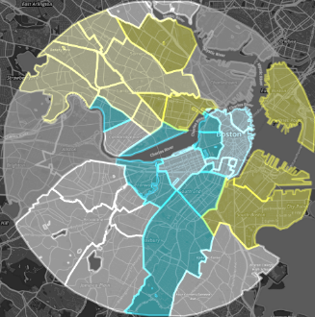
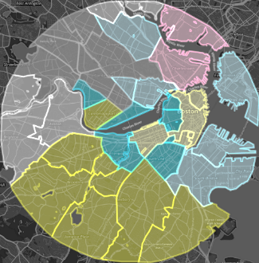
What was NOT learned – undistinguishable categories
Confusion matrix, classes sorted by affinity
Neighborhood affinity clusters
n_clusters=2
n_clusters=3
n_clusters=4
n_clusters=5
n_clusters=6
n_clusters=7
Neighborhood-based classification not good enough. Unable to detect:
In-class inconsistency
Inter-class similarity
Artificial boundaries
Notes:
After the model has finished training, in addition to model accuracy, we thought it’s equally important to understand what the model has not learned. We clustered all Boston neighborhoods based on their affinity (affinity being proxied by mis-classification rates). You can see from the maps view that neighborhoods within the same clusters also tend to be spatially close to each other.
Apparently, there are more to visual characteristics boundaries than preexisting neighborhood boundaries can describe, and therefore neighborhood-based classification might not be extremely helpful for our task.

Slide 7
Discovering Perceptual Neighborhoods
Bottom-up approach to identify visually similar regions, based on image features.
“Beacon Hill”
“Beacon Hill”
4096-dimensional feature vector
However, inspecting spatial distributions of these features via simple mapping becomes difficult.
Solution: unsupervised learning on feature vectors & exploratory vis tool
Notes:
That’s why a bottom-up approach is needed to re-define the boundary of neighborhoods, purely from image features. We use our CNN in a different way, by extracting the learned representation from the second fully connected layer as feature vectors.
These features are ‘unnamed’ and inconspicuous in their visual meaning, and inspecting these features becomes difficult.
Therefore, we demonstrate combined use of an unsupervised learning technique and an interactive visualization tool to interpret and evaluate the results

Slide 8
Agglomerative clustering of visual features
Agglomerative clustering
Parameters:
Euclidean affinity
Ward linkage (minimizes the variances of clusters being merged)
Advantages for the visualization:
Describes the level of similarity between two images (not just whether they are similar or not similar).
A
B
C
D
E
Hierarchy-constructing process in Agglomerative Clustering.
ABCDE represent a collection of data points with different distances from each other in a one-dimensional space.
Notes:
We applied agglomerative clustering to the feature vectors (with Euclidean affinity and Ward linkage).
We think of the clustering method as a data processing instrument for our visualization. The nice thing about it is that it not only produces a specific clustering, but also computes a hierarchy of clusters that can be used to describe, e.g. not only two images are similar or not similar, but also the various levels of similarity.

Slide 9
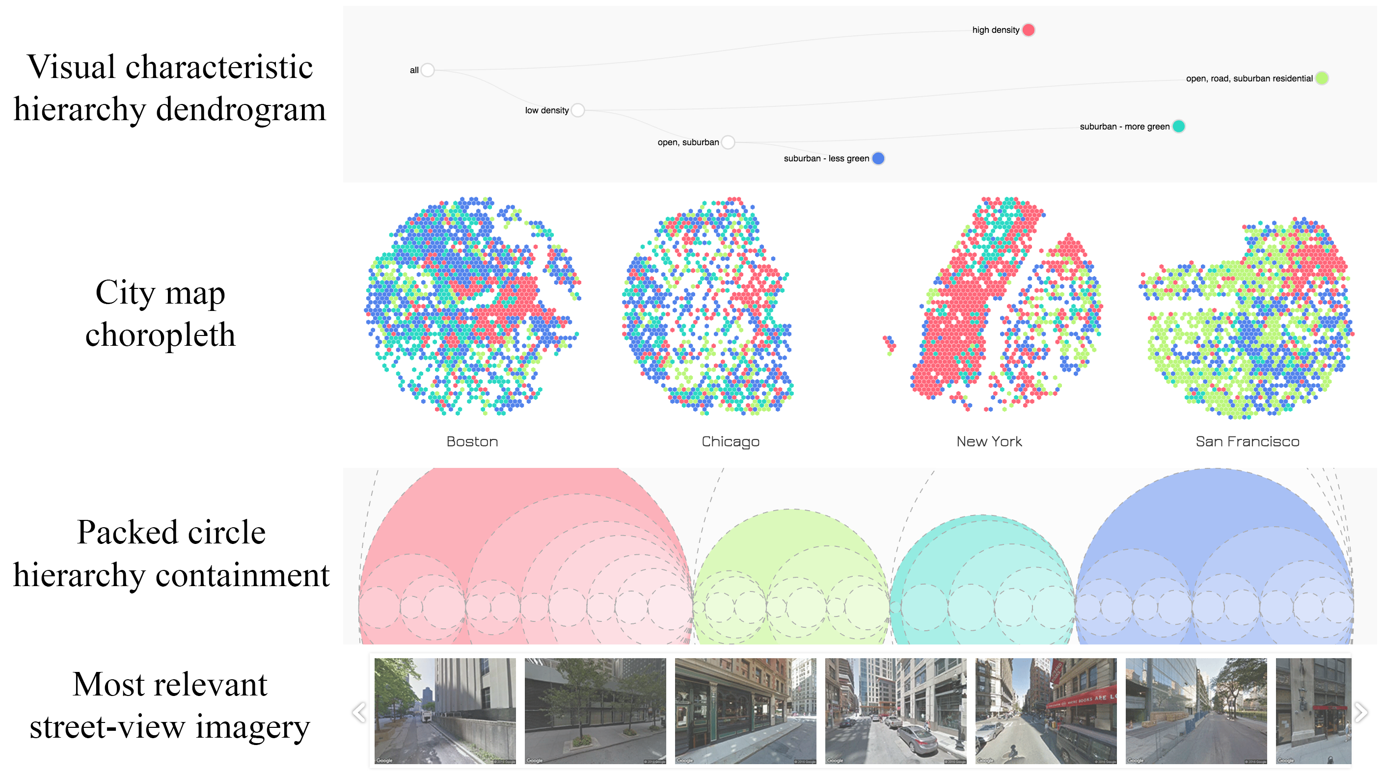
Interface
Notes:
Here is the visual interface which consists of 4 coordinated views. From top to bottom, the hierarchy is shown by a dendrogram, the geo-locations are shown by maps, and the categories are shown by a circle packing. Colors across all 3 views represent the same set of street view images, which can be shown as thumbnails at the bottom, on click.

Slide 10
Design considerations
Evaluating the effectiveness of the model
Exploration of city structures (distribution of “perspective neighborhoods”)
Easy to read, self-evident about data manipulation method
Notes:
This design addressed 3 main considerations:
To help evaluate the effectiveness of the deep learning model
To support exploration and understanding of the structures of cities, i.e. distribution of ”perspective neighborhoods”
To be easy to read for it audience and be self-evident about the data manipulation method used.
Let’s look at how these considerations are addressed through a demo.

Slide 11
Demo
Notes:
Users start from the top of the hierarchy, where the most significant visual differences within the set is indicated by orange and blue. And each time they click on a node, it’s further divided into subsets. This process can be repeated to query for increasingly refined subdivisions based on visual similarities. Remember that same color represent the same set of images, therefore the splits of clusters happen simultaneously in the coordinated views. It’s noticeable in maps view that same-color patches tend to concentrate locally, but are also somewhat evenly allocated among 4 cities. When you want to look at what actual images are in the different subsets, you click on the circles to compare them.

Slide 12
Take-away’s
At a local scale:
Visually similar images display a tendency to be geo-spatially close to each other
(e.g., high-density areas within one city tend to concentrate)
At a global scale:
Corresponding districts in different cities / regions are visually close to each other
(e.g., high-density areas in Boston tend to look like high-density areas in Chicago)
Conforms with our common perceptions of cities.
Notes:
A very quick take-away based on what we saw in the results:

Slide 13
1. Evaluation of neural net training results
Problem:
Unsupervised learning doesn’t have an accuracy metric
Solution:
Involve people’s judgement in the loop
Human knowledge
knowledge of the geography
perception of image similarities
Notes:
Some further look into the design… Because we are using the neural nets in an unsupervised fashion, there’s no more such a thing as “ground truth” to evaluate the model against. So the best we can do to measure success is to include a human in the loop and allow both their knowledge of the geography and their perception of image similarities to make judgements on the outcome

Slide 14
2. Exploration of perspective neighborhoods
Problem
Multiple levels of similarity and dissimilarity
Solution
Highest-level difference shown first
Details on demand
Notes:
For the purpose of exploring perspective neighborhoods, the difficulty lies in that there can be multiple levels of differentiation which cannot be shown at the same time. In our system, we ensure users see the most significant differentiation first (which is high or low density). And then they can start querying for more details down the hierarchy.

Slide 15
3. Being easy to read & self-explanatory
Problem
“Tree” concept used in data processing isn’t very straightforward
Solution
Two charts explain the concept from two aspects
A
B
C
Increasing similarity threshold
Two aspects of hierarchy
Branching/merging analogy
containment information
A
C
B
# of images in set
Notes:
Making a hierarchy out of data points isn’t the most straightforward data manipulation. To make the concept more accessible, we include both a dendrogram and a circle-packing representation. They combined convey both a branching and a containment analogy, and provide numerical information of threshold levels of merges, as well as the number of images in the subsets.

Slide 16
Conclusion
Contributions:
Applying DL + VIS in urban studies field, providing easier image cataloging and querying
Evaluating ML output when targets are missing, by involving humans in the loop
Vis for analyzing hierarchical geographical data
Notes:
To conclude, in this paper we applied… Proposed a way to… And it also designed…

Slide 17
Conclusion
Finding connections between visual features and internal meaning of the built environments (form follows function)
Patterns from the top-down view
(urban morphology)
Patterns from street-level perspectives
(this paper)
http://www.urbanmorphologyinstitute.org/
http://helmofthepublicrealm.com/category/urban-morphology/
Notes:
From the application point of view,
The connection between visual features and internal meaning of the built environments has always been a principle topic in urban design and planning (“form follows function”).
Traditionally, we have looked at patterns in a city from a top-down view, e.g., aerial imagery
Our proposed visual analytics methodology tests the idea that street-level visual properties also demonstrate significant patterns that are relevant to the study of the built environment.

Slide 18
Thank you!
Lezhi Li | lezhi.li@uber.com
James Tompkin | james_tompkin@brown.edu
Panagiotis Michalatos | pmichala@gsd.harvard.edu
Hanspeter Pfister | pfister@seas.harvard.edu

